Slide 1


NORCO UNIVERSITY
Notes:
Welcome to Norco University. Today we will be discussing the BAL Exact Slide.

Slide 2

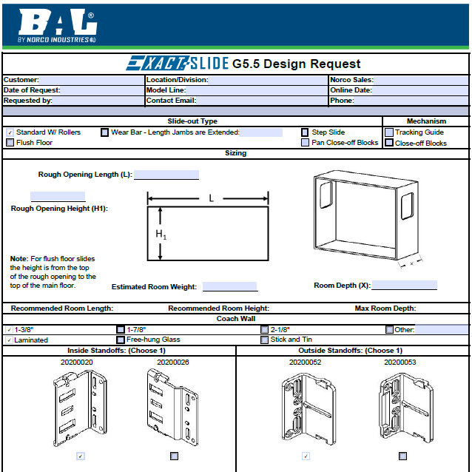

DESIGN PROCESS
WALL OPENING HEIGHT
WALL OPENING LENGTH
ROOM DEPTH
ROOM WEIGHT
WALL THICKNESS
FLUSH FLOOR
WEAR BAR
ROLLERS
STICK AND TIN
LAMINATED
FREE HUNG GLASS
Notes:
Our first step in the design process is to meet with the OEM team, Plant manager, Engineer, sales manager, purchasing etc. Our Sales team will provide a design request form and go over the many options we have as well as the capabilities of the exact slide.

Slide 3

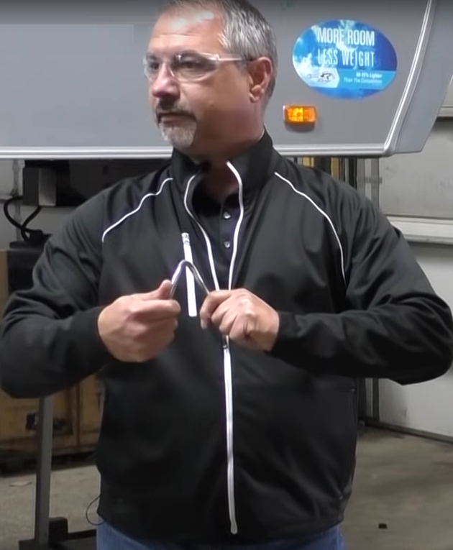
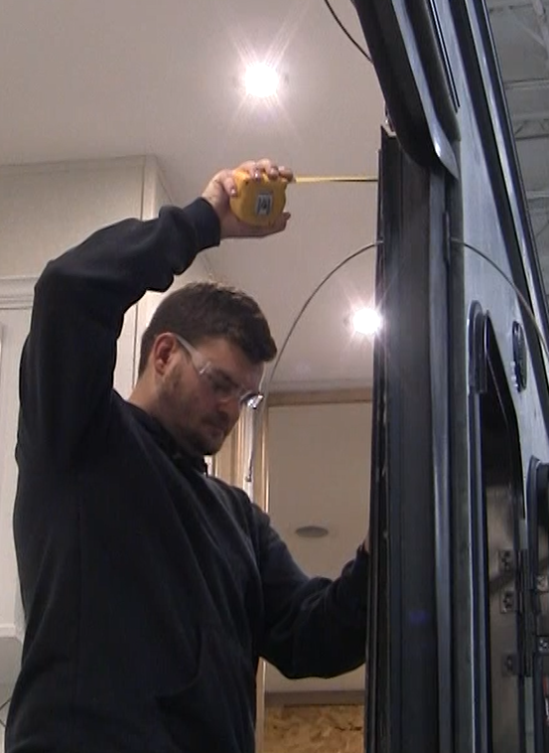
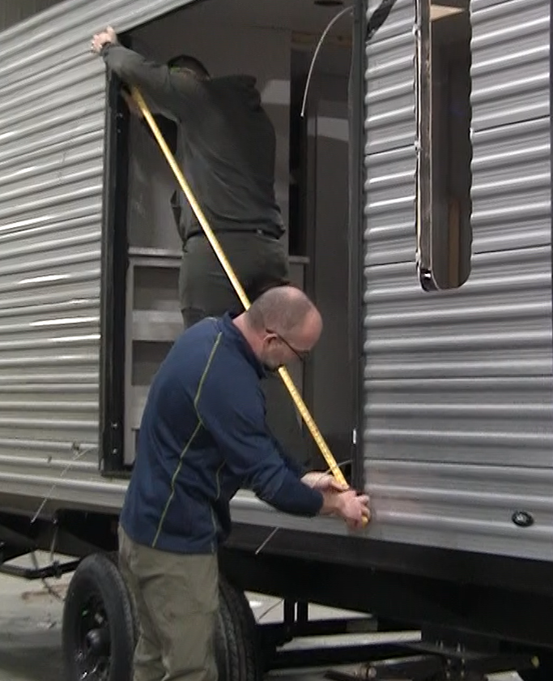
Notes:
When we have all the design request info we will produce a prototype, where we will schedule a time and date to install the prototype on or offline. Our sales team along with our technical team will be present during this installation to ensure everything goes smoothly and to document any changes that may need to be addressed prior to the first run. Our team will be present through the first run as well to train and assist the individuals installing and adjusting the slides to ensure everyone is aware of the expectation of the final product. Once they are comfortable with the installation we will be in periodically to audit the process to ensure there are no issues once the product leaves the OEM facility.

Slide 4
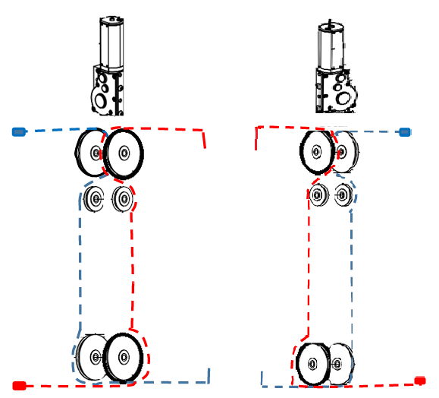
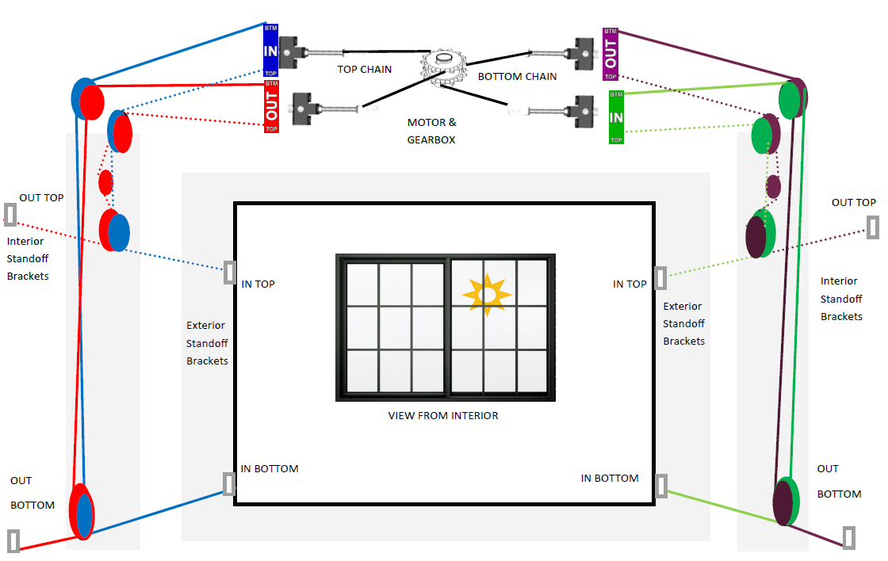
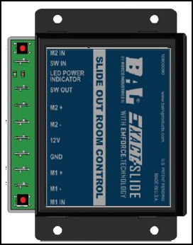
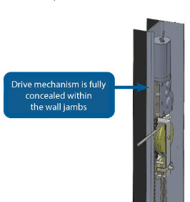
EXACT SLIDE vs. ACCU SLIDE
Dual Motors Mounted at TOP and Left of Slide
Single Motor Mounted above or below the slide
ACCU SLIDE
EXACT SLIDE
Notes:
The two main differences between the accuslide and exact slide are the motors and the motor controller. Accuslide has a single motor that is mounted at the top or bottom of the rough opening while the Exact Slide has dual motors located at the top of our jambs on the left and right side of the opening. A motor controller with emforce technology is used to keep the motors synced and keep the timing of the room in sequence.

Slide 5
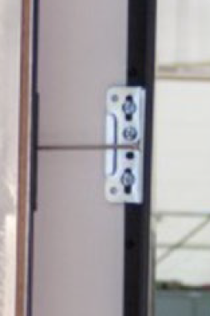
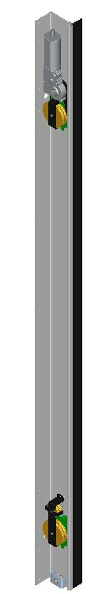

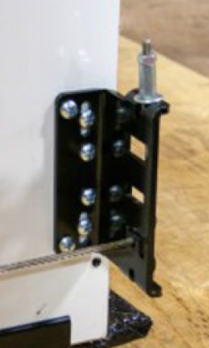
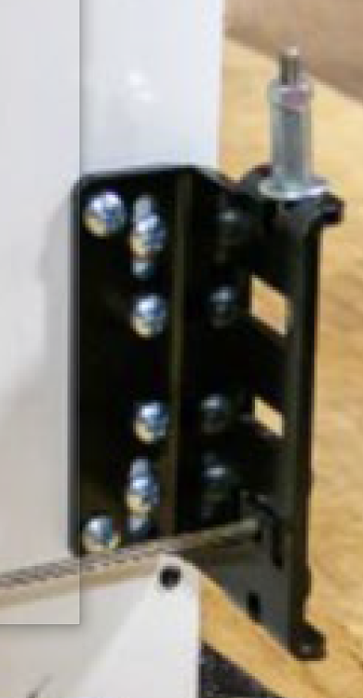

Terminology Overview
EXTERIOR STANDOFF BRACKETS: BRACKETS THAT ARE FASTENED TO THE SIDES OF THE SLIDE ROOM END WALLS, THAT THE BALL ENDS OF EACH CABLE ENDS ATTACH TO ON THE EXTERIOR DIRECTLY BEHIND THE EXTERIOR T-MOLD.
JAMB: THE LEFT OR RIGHT ASSEMBLY THAT IS FASTENED TO THE ROUGH OPENING, CONTAINING THE PULLEYS, WITH THE CABLES ROUTED THROUGH THEM.
JAMB CLAMP: THE LEFT OR RIGHT CLAMP THAT IS FASTENED TO THE INTERIOR RV SIDE WALL TO SECURE THE JAMB TO THE OPENING AND ELIMINATE TWISTING.
LEFT AND RIGHT HAND: LEFT HAND AND RIGHT HAND COMPONENTS ARE DETERMINED BY STANDING INSIDE THE RV FACING THE SLIDE ROOM.
INTERIOR STANDOFF BRACKETS: BRACKETS THAT ARE FASTENED TO THE SIDES OF THE SLIDE ROOM END WALLS ON THE INTERIOR, THAT THE THREADED ENDS OF EACH CABLE ATTACH TO ON THE INTERIOR.
CABLE ADJUSTMENT/TENSIONING: CABLES ARE ALWAYS ADJUSTED AT THE INTERIOR STANDOFF BRACKETS. NEVER ADJUST INSIDE THE JAMB ASSEMBLY WHERE THE CABLES CONNECT TO THE CHAIN.
CONTROLLER: LOCATED SOMEWHERE BETWEEN THE SLIDE SWITCH AND THE MOTORS WITHIN THE 12 VOLT POWER SUPPLY.

Slide 6

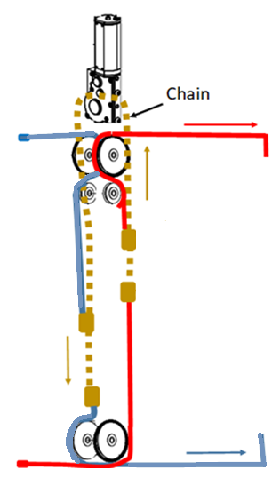

Cable To Chain Relationship
EXACT SLIDE G5.5
WHEN THE SLIDEOUT RETRACTS, AS THE ROOM COMES IN, THE TOP INTERIOR CABLE IS PULLING IN THE BOTTOM EXTERIOR CABLE.
Exterior
THE EXTERIOR BOTTOM CABLE IS CONNECTED TO THE INTERIOR TOP CABLE BY THE CHAIN.
Interior

Slide 7
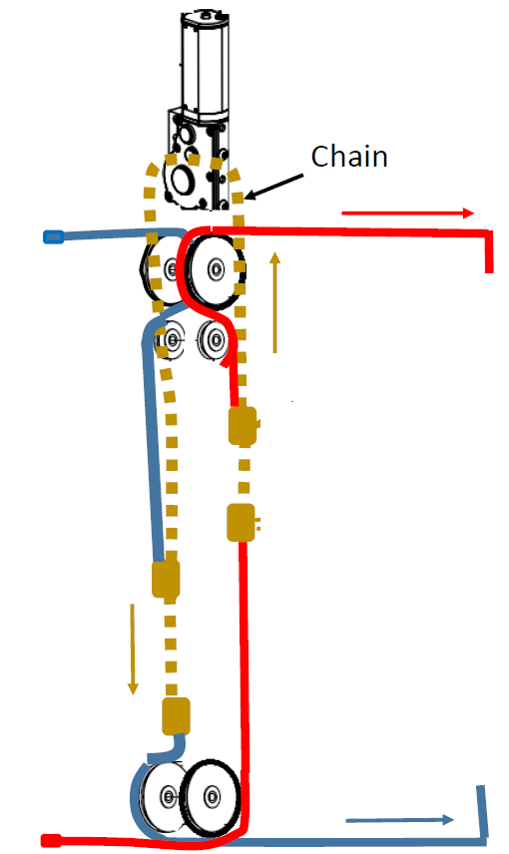
Cable To Chain Relationship
EXACT SLIDE G5.5
THE EXTERIOR TOP CABLE IS CONNECTED TO THE INTERIOR BOTTOM CABLE BY THE CHAIN.
WHEN THE SLIDEOUT RETRACTS, AS THE ROOM COMES IN, THE BOTTOM INTERIOR CABLE IS PULLING IN THE TOP EXTERIOR CABLE.

Slide 8
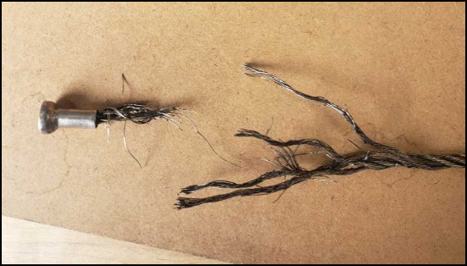
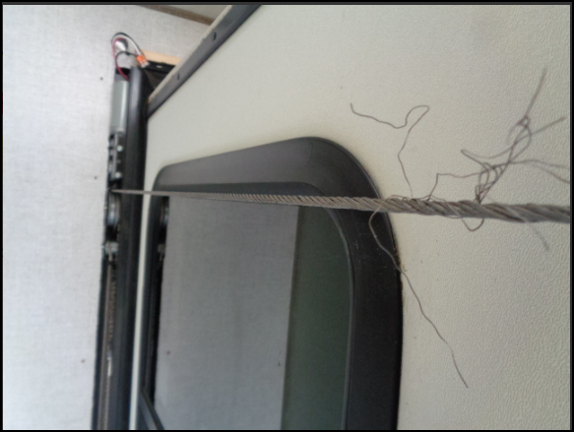

What Causes Frayed Exterior Cables?
AIRCRAFT CABLES ARE PULL TESTED FOR 2,000 LBS. WHEN THEY FRAY OR BREAK THERE IS A ROOT-CAUSE THAT MUST BE DETERMINED AND ADDRESSED TO AVOID A REPEAT FAILURE.
Notes:
Aircraft cables are pull tested for 2,000 lbs. If you come across a frayed or broken cable, its critical that the root cause of the failure it found and addressed so there is not a repeat failure of the cable once the replacement is installed.

Slide 9
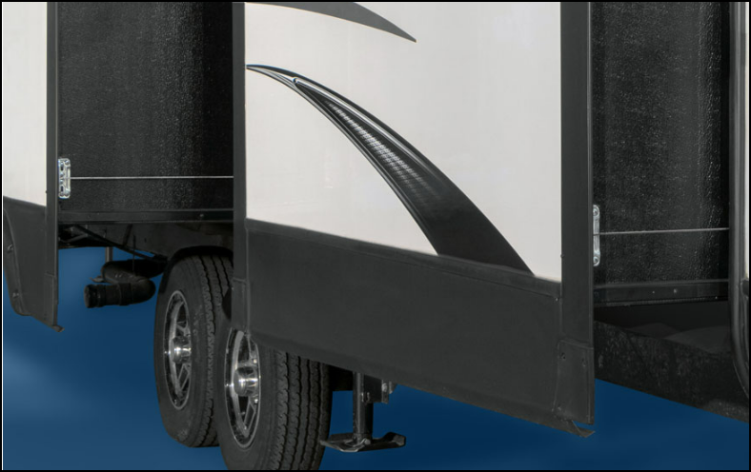
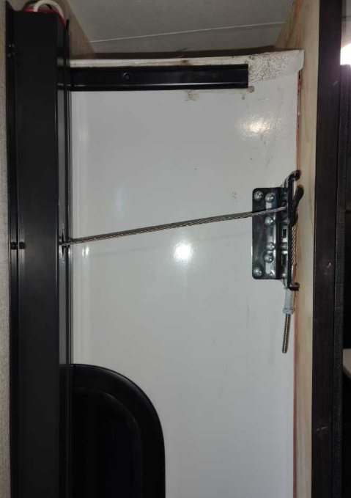
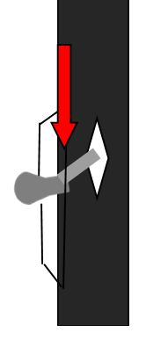
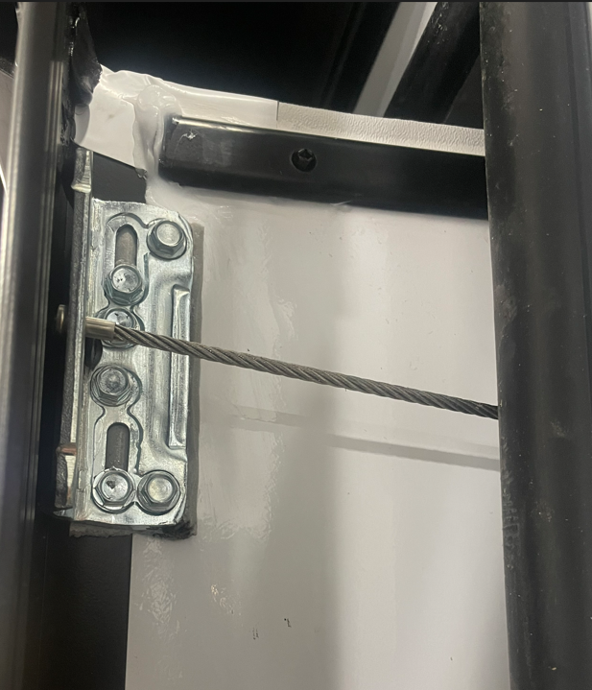
What Causes Frayed Exterior Cables?
The exterior cables have a ball end or bullet end, that sits in the standoff bracket.
With the room extended 6”, ensure the cable is centered with the hole in the jamb.
Standoffs mounted too low or high will cause the bullet end to pinch when it closes against the jamb.
6” Extended
Notes:
Stand off bracket placement is the number one cause of cable failures in the field. To ensure proper placement, retract the room to a position of 6” from sealing. Take a visual inspection of the cable attached to the standoff bracket and ensure the cable is running straight into the jamb. Move the standoff bracket up or down using the slotted holes in the stand off bracket to achieve this. A bracket that is mounted to high or low will pinch the bullet end of the cable as the room is sealing. Road vibration will act as a seesaw effect on the cable during transit and break one strand at a time.

Slide 10
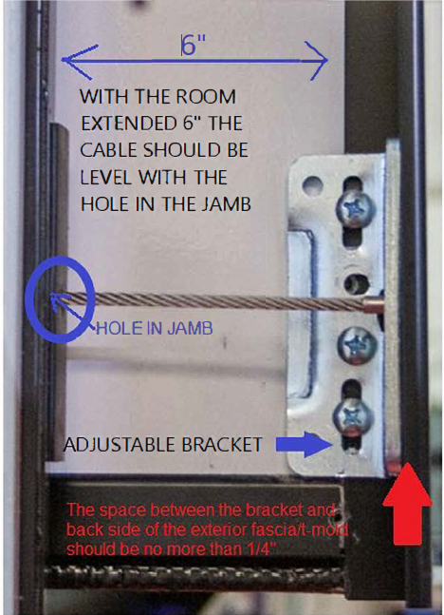
Adjusting The Standoff Bracket Location

Slide 11
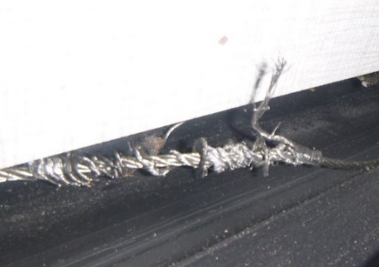
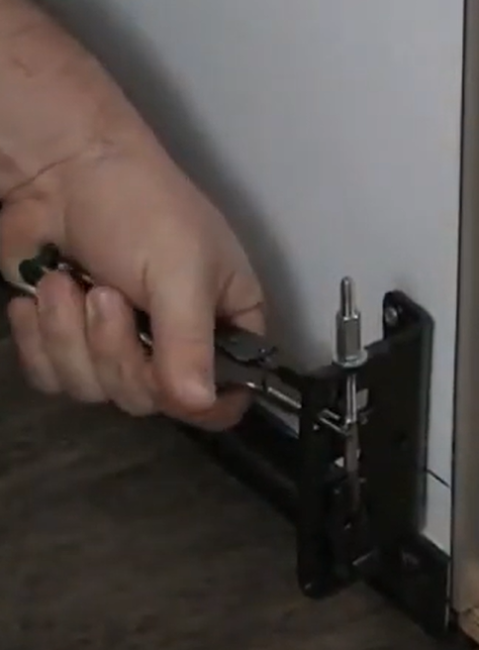
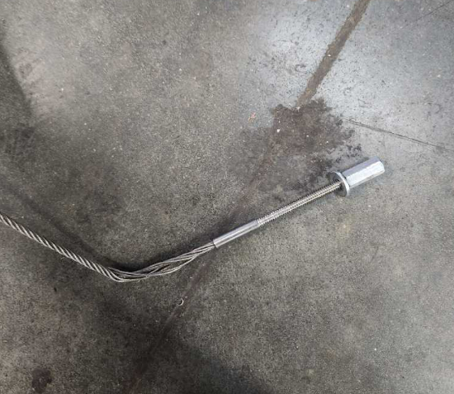
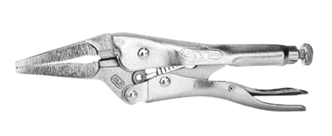
Cable strands twisted around the cable
Adjusting the system without holding the threaded end of the cable in place with needle nose vice grips will twist the cable at the same time.
Cable strands unspun
CLAMP TO BARREL AREA OF CABLE END
Notes:
Cable strands twisted around the cable. This is usually caused by making adjustments on the cable while not having a clamping set of needle nose pliers attached to the smooth barrel area of the adjustment stud. As you add tension to the cable adjustment nut the cable becomes unspun right behind the cable stud. A replacement is required if this happens.

Slide 12
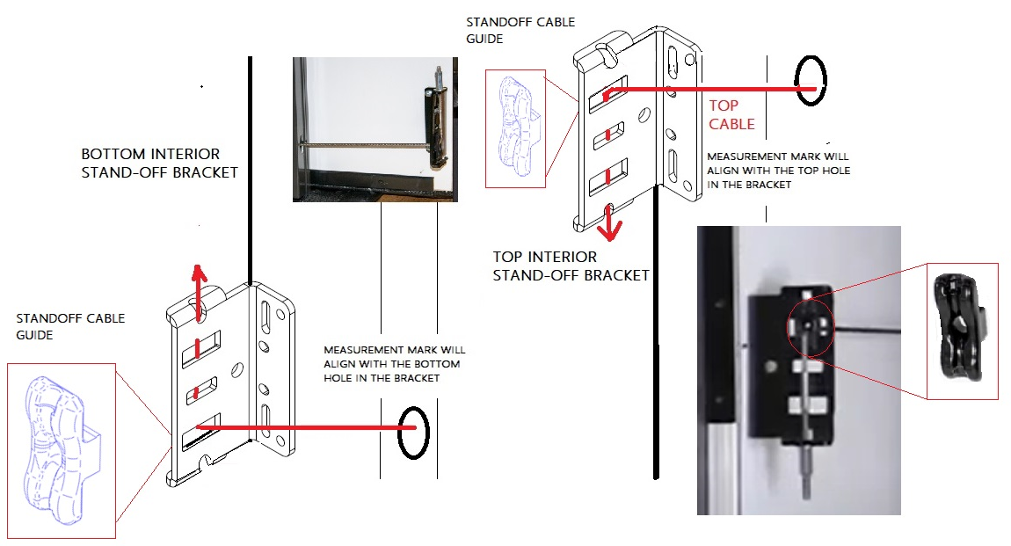
Interior Standoff Bracket Location

Slide 13
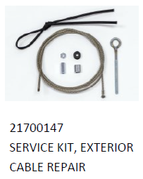
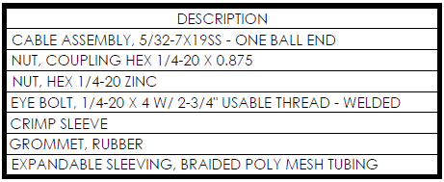
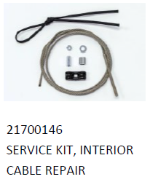
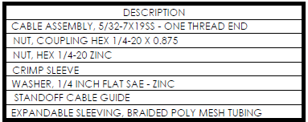
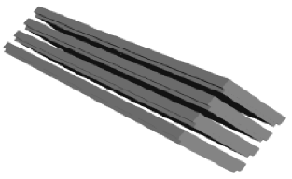
Cable Replacement Kits
Pro Tip: The Accu-slide cable replacement kit 22305 can be used for the exterior cable replacement on the Exact Slide.
25041
CABLE PATCH KIT (SET OF 4)

Slide 14
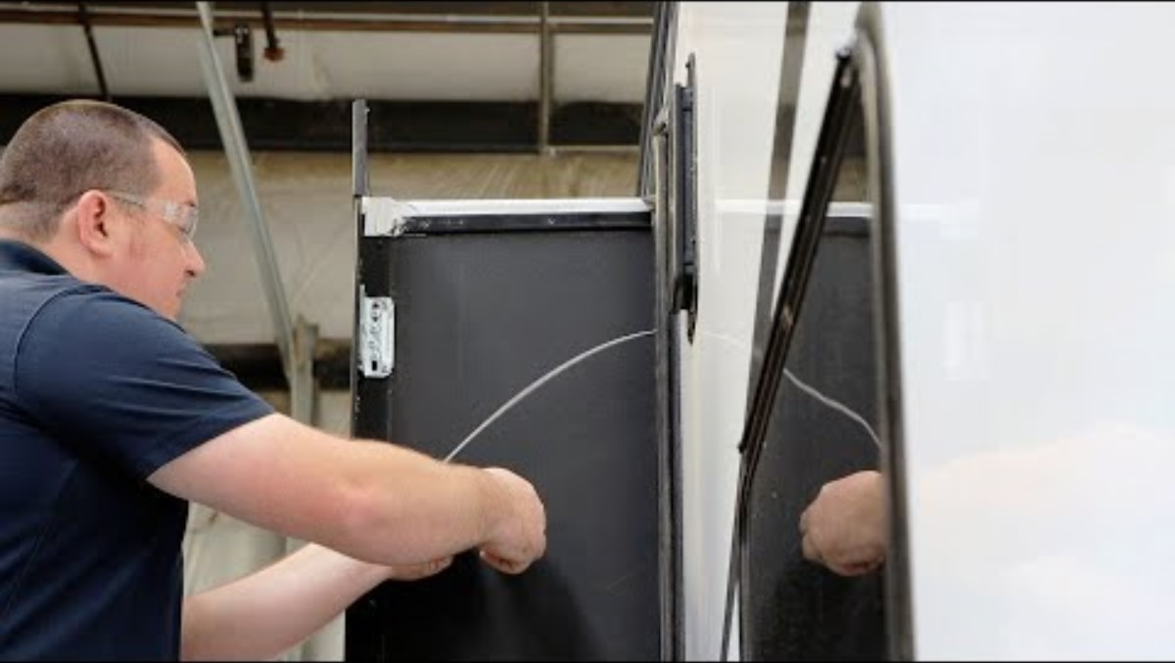

Top Exterior Cable Replacement Procedure
BAL EXACT-SLIDE Top Exterior Cable Replacement Procedure Link to Video

Slide 15
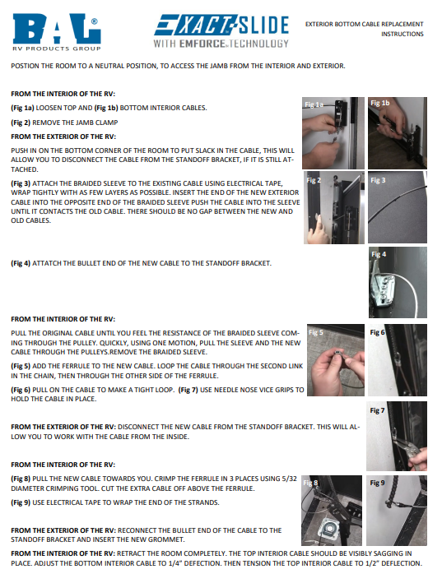

Top Exterior Cable Replacement Procedure
BAL EXACT-SLIDE Bottom Exterior Cable Replacement Procedure Link to PDF

Slide 16
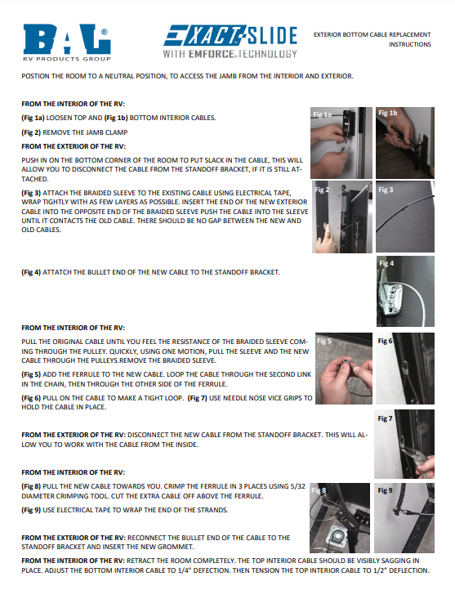

Bottom Interior Cable Replacement Procedure
BAL EXACT-SLIDE Bottom Exterior Cable Replacement Procedure Link to PDF

Slide 17


Slide 18
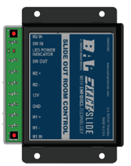

Resistance
Resistance can come in the form of physical resistance from the glide surface, physical resistance between the slide room and the opening, weakened motors or a voltage drop (amp spike) during operation.
The controller is designed to evaluate the resistance from each motor and travel distance in motor revolutions. The controller will cut power to a motor if the resistance tricks the controller into thinking one side of the room is already out or in.
Resistance can present itself with the following symptoms:
One side of the room is slower
One side of the room walks out
One side of the room starts and stops
The room struggles to retract
  Checking the glide surface for resistance is the first step.

Slide 19
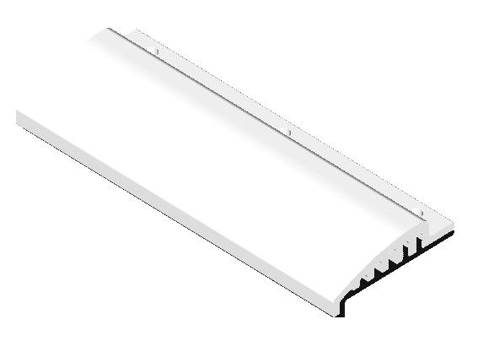
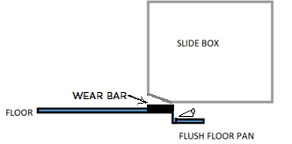
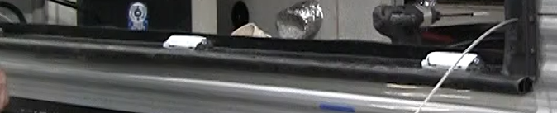
Identify the Glide Surface
WEAR BAR
FLUSH FLOOR
What is the slide room gliding on?
ROLLERS

Slide 20
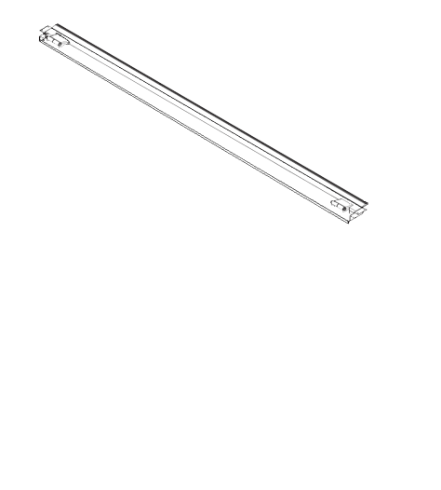
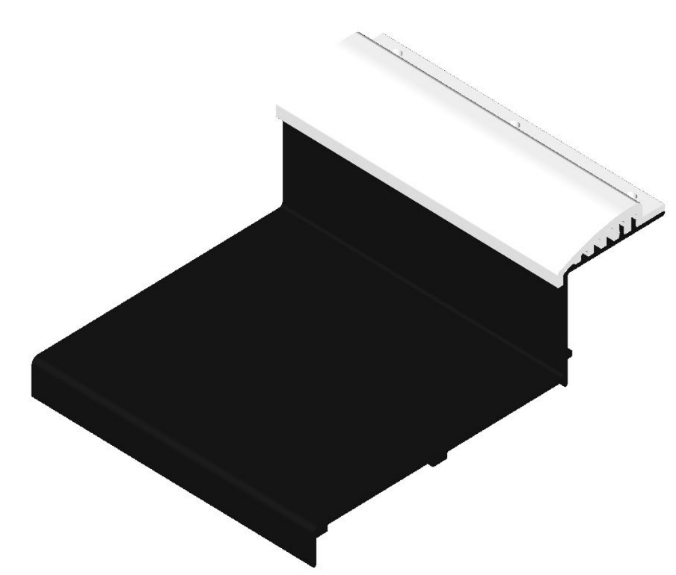
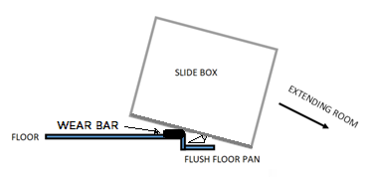
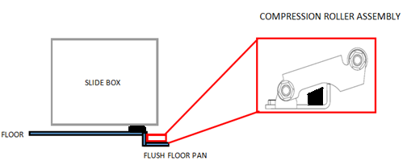
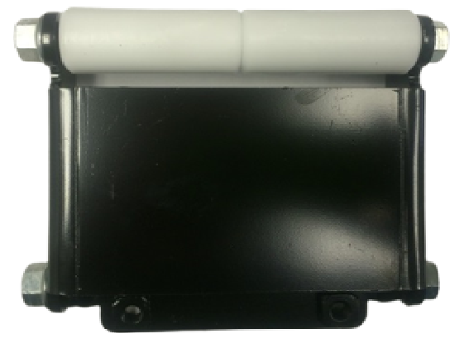
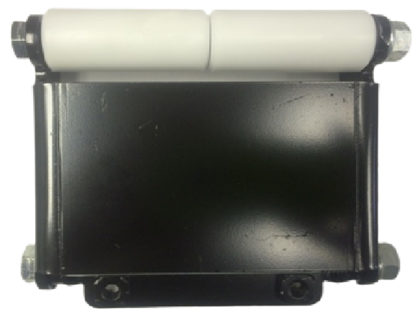
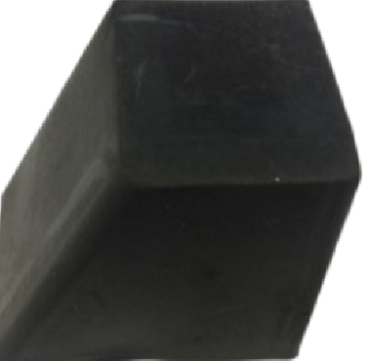
Flush Floor Design
Combination of wear bar, pan and compression rollers.
WEAR BAR
FLUSH FLOOR PAN
COMPRESSION ROLLER AT EACH END OF THE PAN
Is the rubber block damaged?

Slide 21
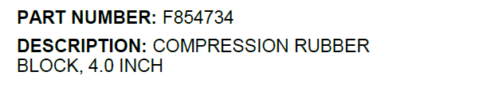
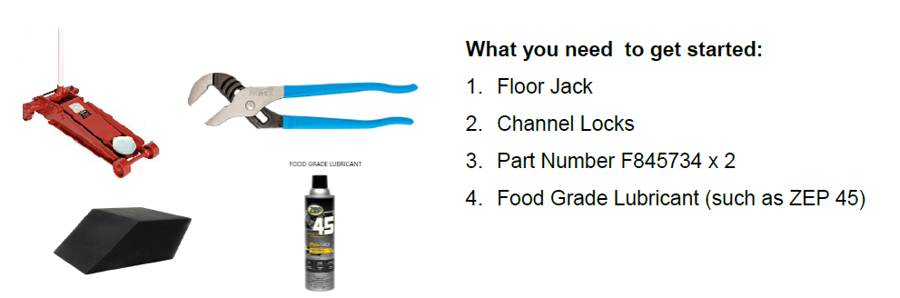
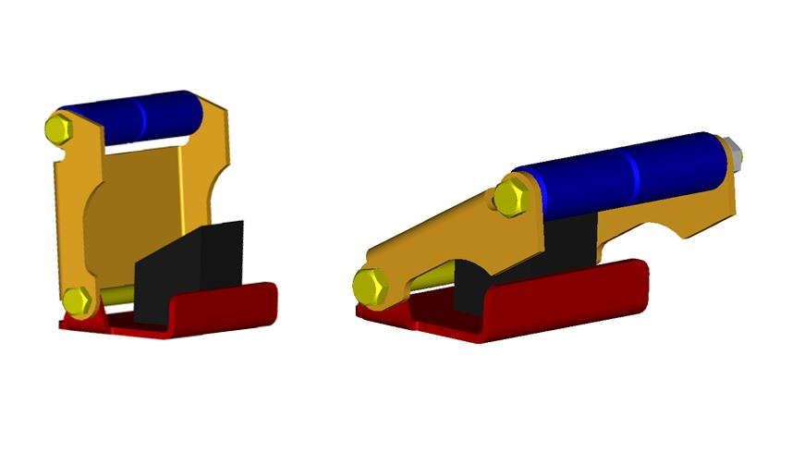
Flush Floor Design – Replacing the Rubber Block

Slide 22
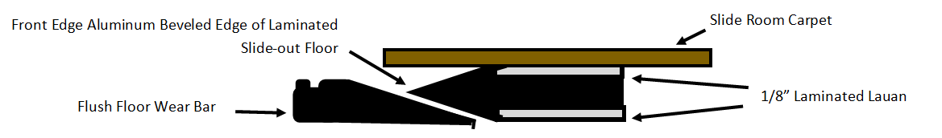
Alternate Flush Floor Design
Verify exposed exterior surface of floor is not loose and catching during retraction of slide.
Notes:
Faux Floor design where the lauan comes loose from floor of slide box causing lauan to catch on wear bar material. Abrupt retract or stopping room from coming in.

Slide 23
Alternate Flush Floor Design
PLASTIC GLIDE STRIP PIECES ALONG INSIDE EDGE OF METAL PAN
NEWER FAUX FLUSH FLOOR DESIGN FOR THE INDUSTRY FOR 2024
BOTTOM OF SLIDE FLOOR HAS A BEVELED NOSE THAT GLIDES ACROSS THE METAL SLOPED MAIN FLOOR PAN
Notes:
No testing on these pans with our system as well as the transition not being as smooth as it would be with Norco pan and wear bar combination. Many OEM'S using this instead as an alternative to our product to save $$$.

Slide 24
Checking Resistance on Wear Bar or Rollers
When the weight it off the rollers, do they easily spin by hand?
Are all rollers touching the bottom of the room during operation?
How many rollers are installed under the room? Most roller are rated for 150 lbs – 200 lbs, depending on the supplier.
Verify the fasteners in the wear bar are not sitting higher than the wear bar.
Verify the wear bar is not wavy.
Verify the wear bar is not grooved or damaged.
How long the room is and what appliances/furniture are installed?
Note: Refrigerators are approx. 12 lbs per cubic foot.

Slide 25
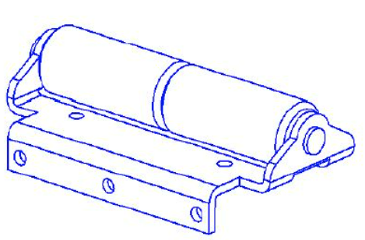



Adding Additional Rollers
=
SERVICE ROLLERS AT THE SAME HEIGHT OF THE ORIGINAL 1.00” ROLLERS CAN BE ADDED WITHOUT REMOVING THE SLIDE.
Link to roller installation instructions
½” TALL ROLLER – PART NUMBER 854304
¾” TALL ROLLER – PART NUMBER 854303

Slide 26

Weight Limitations for the Exact Slide
BAL SLIDE TYPE | GLIDE SURFACE | MAX ROOM WEIGHT
EXACT SLIDE | BAL ABOVE FLOOR ROLLERS | 1700
EXACT SLIDE | ABOVE FLOOR SOLID CORE WEAR BAR | 1500
EXACT SLIDE | BAL FLUSH FLOOR PAN | 1100
EXACT SLIDE | METAL FAUX FLOOR WITH 12 DEGREE RAMP | NOT TESTED
EXACT SLIDE | FOREST RIVER GIGGY FLOOR | 860
BAL Rollers are rated for 200 lbs. Additional rollers may be required depending on the application.

Slide 27


Resistance
You should have a 5/8" gap from top to bottom on each side of the room between the slide-out end wall and the metal portion of the jamb, when pulling back the wipe seal, as the overall width of the rough opening, before the jambs are fixed to each side should be 5.25" wider than slide box (finished edge of fiberglass to finished edge of fiberglass).
If there is not 5/8" clearance from top to bottom on both sides, then you will want to check the following and then reach out to the RV OEM with your findings on the VIN for guidance.
Confirm that the jamb assembly is fully seated against the rough opening.
Confirm that the jambs are not twisting during operation of the room.
Cross measure the slide room for squareness.
If you find that the gap on each side of the room changes, during extend/retract, measure the interior width of the slide at the back of the slide room and the interior width of the slide at the front of the slide room.

Slide 28



Video of Chain Binding in Jamb
MOTOR SPROCKET

Slide 29

What causes the popping and grinding sound in the system?
#1 MISDIAGNOSED CUSTOMER COMPLAINT
#1 PHONE CALL TO BAL TECHNICAL SUPPORT

Slide 30

Slack Trapped In The Chain Between Top Pulley and Motor/Gearbox Sprocket
LEFT HAND JAMB ASSEMBLY EXAMPLE
When the top interior cable is tensioned before the bottom interior cable, it pulls the chain up and traps slack between the gearbox sprocket and top pulley.
MOTOR SPROCKET
NEVER ADJUST THE CHAIN INSIDE THE JAMB
The chain will fold over itself below the gearbox sprocket, making a loud pop as the sprocket slips past the links.

Slide 31


Slack Trapped In The Chain Between Top Pulley and Motor/Gearbox Sprocket
GEARBOX ON MOTOR
LEFT HAND JAMB ASSEMBLY EXAMPLE
CHAIN SLACK
When the top interior cable is tensioned before the bottom interior cable, it pulls the chain up and traps slack between the gearbox sprocket and top pulley.
The chain will fold over itself below the gearbox sprocket, making a loud pop as the sprocket slips past the links.
TOP PULLEY

Slide 32


All 4 Cables in The Jamb Connect to One Chain
With all 4 cables connected to the same chain, as the slack is adjusted out of the bottom interior cable with the room completely retracted, it is pulling slack out of all the cables.

Slide 33


Before Tensioning the Cables
INTERIOR FASCIA
EXTERIOR T-MOLD
INTERIOR FASCIA
EXTERIOR T-MOLD
When operating the room, do the end walls of the slide flex?
When operating the room, do the interior stand off brackets pull away from the wall?
RETRACT 6” TO CHECK INTERIOR BRACKET PLACEMENT
EXTEND 6” TO CHECK EXTERIOR BRACKET PLACEMENT
Do the interior cable end at the standoff brackets have a washer, coupler nut and 1/4" jamb nut at the end of each threaded rod?
Are the interior and exterior standoff brackets within 1/8”-1/4” from the exterior t-mold and interior fascia?
Are the interior and exterior standoff brackets installed to allow the cables to be level with the hole in the jamb when the room is extended and retracted 6”?

Slide 34






TENSIONING PROCESS
RETRACT THE ROOM
Banjo string tight.
1. REMOVE THE TOP JAMB NUT AND LOOSEN THE COUPLER NUT
2. REMOVE BOTTOM ¼” JAMB NUT
3. TENSION THE BOTTOM CABLE TO ¼”DEFLECTION
4. LEAVE THE TOP CABLE LOOSE
5. CYCLE THE ROOM X 3
6. CHECK TENSION ON BOTTOM CABLE TO SEE IF IT HAS LOOSENED.

Slide 35

TENSIONING PROCESS
7. REPEAT THE PROCESS FOR THE BOTTOM CABLE IF NEEDED.
8. LEAVE THE TOP CABLE LOOSE.
9. CYCLE THE ROOM X 3 AFTER EACH BOTTOM CABLE ADJUSTMENT.
10. ONCE YOU CAN CYCLE THE ROOM 3 TIMES WHERE THE TENSION IN THE BOTTOM INTERIPR CABLE STAYS AT ¼” DEFLECTION, YOU CAN TENSION THE TOP CABLE.
11. TENSION THE TOP CABLE TO ½” DEFLECTION AND REINSTALL THE ¼” JAMB NUTS ON ALL CABLE ENDS TO LOCK THE TENSION IN PLACE.
12. PRESS AND HOLD THE RED BUTTONS ON THE CONTROLLER UNTIL THE RED-LIGHT BLINKS TO RESET THE CONTROLLER.

Slide 36


Removing The Slack In The Chain
STILL CAN’T GET THE SLACK OUT?
OBTAIN THE SLIDE ID INFORMATION FROM THE LABEL INSIDE THE JAMB ASSEMBLY.
MEASURE THE ROOM DEPTH AND HEIGHT.
MEASURE THE ROUGH OPENING HEIGHT.
EMAIL INFO TO BALTECHSUPPORT@NORCOIND.COM
WITH THIS LABLE INFORMATION WE CAN PULL THE SPECS
Notes:
Do not make any changing to the adjustment with the jamb itself. Call customer support with mechanism number and date on inside of jamb and we will check and see if it was built correctly and if changes can be made or if a new mechanism needs to be ordered and sent out to you.

Slide 37


Checking the Tension by Sound
VIDEO OF THE SOUND
VIDEO OF THE SOUND
BOTTOM INTERIOR CABLE TOO LOOSE
BOTTOM INTERIOR CABLE CORRECT TENSION
REMEMBER:
LEAVE THE TOP INTERIOR CABLE LOOSE, UNTIL YOU CAN CYCLE THE ROOM 3 TIMES AND MAINTAIN THE CORRECT TENSION IN THE BOTTOM CABLE.

Slide 38



Checking the Tension with Gauge
REMEMBER
LEAVE THE TOP INTERIOR CABLE LOOSE, UNTIL YOU CAN CYCLE THE ROOM 3 TIMES AND MAINTAIN THE CORRECT TENSION IN THE BOTTOM CABLE.
Notes:
Pick up on amazon,ebay or loosnaples.com. Amazon your best bet.

Slide 39




Failed gearbox in motor assembly
MOTOR/GEARBOX REPLACEMENT VIDEO
VIDEOS OF MOTOR AND GEARBOX FAILURES
Notes:
Be sure to order proper motor LH or RH side if you need a replacement. Also make sure on built date inside of jamb does not fall in the dates from when we changed to a 10 tooth sprocket from the original 12 tooth sprocket. Dates coming two slide shows from now.

Slide 40
Motor and Gearbox Replacement
Notes:
Be sure to order proper motor LH or RH side if you need a replacement. Also make sure on built date inside of jamb does not fall in the dates from when we changed to a 10 tooth sprocket from the original 12 tooth sprocket. Dates coming two slide shows from now.

Slide 41

ROOM LEANING?
THE STANDOFF BRACKETS ACT AS A STOPPING POINT FOR THE ROOM DURING TRAVEL.
VERIFY THAT THE STANDOFF BRACKETS ARE NOT BENDING OR PULLING AWAY FROM THE WALL.
Room leaning

Slide 42


Out of Sync
Slide-out Box
Seals in the Open Position
4”
2”
During extend or retract
Slide-out Box
Slide-out Box
Seals in the Closed Position

Slide 43



BEWARE OF THE G5 WITH TIMING SHAFT
ADJUSTMENTS ARE NOT COMPLETED THE SAME WAY AS AN EXACT SLIDE
Bottom Mount Motors will have a timing shaft at the top of the room under the wipe seal.
DOES NOT USE A CONTROLLER
G5 WITH TIMING SHAFT
Bottom Mount Motors will have a full loop chain.
BOTTOM MOUNT MOTOR SLIDE WITH TIMING SHAFT IS NOT AN EXACT SLIDE

Slide 44


One side moving faster than the other
Has a motor been replaced on one side recently?
12 TOOTH MOTORS WILL HAVE ONE LABEL ON THE MOTOR CYLINDER THAT IS SILVER.
10 TOOTH MOTORS WILL HAVE TWO LABELS ON THE MOTOR CYLINDER. ONE THAT IS SILVER AND ONE THAT IS BLUE.
The controller will not be able to calibrate the speed of the motors if there is a 12-tooth motor on one side and a 10-tooth motor on the other side.

Slide 45

Motor Change from 12 Tooth to 10 Tooth Sprocket

Slide 46



The controller
The new controller was implemented as part of our continuous improvement process.
The new control includes a number of updates such as low voltage protection to protect components from being damaged if someone attempts to use the slide with insufficient Direct Current Voltage.
NEW
WHITE LABEL
BLUE LABEL
Green ON / Red ON –
Low voltage detected. (< 9.0V)
Green FLASH / Red FLASH –
Red then Green = voltage detected on motor 2 during IDLE state (detected miswire)
Green then Red = voltage detected on motor 1 during IDLE state (detected miswire)
Green FLASH / Red OFF –
Repeated retract operation from switch. Time Delay Initiated
Repeated extend operation from switch. Time Delay Initiated

Slide 47







Locating the controller
NEW
WHITE LABEL
BLUE LABEL
The RV OEM selects the location for the controller on every floorplan
Notes:
Contact OEM and ask where they put it on this model.

Slide 48


Low Voltage Protection

Slide 49

Switch and Controller Wiring Options

Slide 50

Switch and Controller Wiring Options

Slide 51

Switch and Controller Wiring Options

Slide 52

Switch and Controller Wiring Options

Slide 53

Switch and Controller Wiring Options

Slide 54




Function of The Jamb Clamp
Cycling the room without the jamb clamp clipped into the jamb from top to bottom could cause the jamb to twist.
The jamb is fastened to the through the exterior of the RV side wall under the bulb seal.
The jamb clamp is clipped into the channel of the jamb and is fastened to the interior of the RV side wall/interior paneling.
The jamb clamp is part of the structure. Removing the clamp will allow the jamb to visibly pivot under the torque of the cables.
JAMB CLAMP
JAMB CLAMP EDGE IS BEVELED TO CLIP INTO JAMB CHANNEL
The aircraft cables can come into contact with the edges of the diamond-shaped holes within the interior jamb clamp. These cables are strong enough to cut through the jamb clamp rather than sustain damage themselves. However, if there's excessive "sawing" of the cable against the metal jamb clamp or exterior extrusion, it requires investigation.
JAMB
EXTERIOR VIEW
SCREWS FASTEN THE JAMB CLAMP TO THE INTERIOR WALL PANEL
SCREWS FASTEN THE JAMB TO THE ROUGH OPENING IN THE SIDE WALL OF THE RV THROUGH THE EXTERIOR, DOWN THE LENGTH OF THE JAMB.

Slide 55



Slide Seal Replacement
To remove the wipe seal: Loosen the pinch points at the top and bottom of the channel with a flat head screwdriver, chisel, screen spline, or putty knife. Then pull the seal out of the channel.
To install new seal:
Use a flat head screwdriver, chisel, screen spline, or putty knife to help press the new seal into the channel, so that the barbs catch inside the channel of the jamb.

Slide 56


Jamb Replacement
If the base extrusion of the jamb is damaged, permanently twisted, or more than two cables on the same side need to be replaced, we recommend to replace the jamb assembly.

Slide 57



Water Infiltration and Where to Investigate

Slide 58


Water Infiltration and Where to Investigate

Slide 59

Water Infiltration and Where to Investigate
RAISED PAN/SILL MATERIAL WITH WATER DAM
THIS IS NOT ENOUGH SEALANT TO CREATE A WATER DAM.

Slide 60





Interior Stand-off Brackets Pulled Out of Wall
Self-tapping screws should not be used when installing the brackets, as that type of screw will act as a drill bit and bore out the hole
6” X 2.88”
6” X 1.13” LIP
21700148
REINFORCEMENT PLATE SERVICE KIT (SET OF 4) 14 GA STEEL E-COAT
Exterior Standoff Brackets may use self-tappers for attachment to exterior t-mold fascia.

Slide 61




Electrical Trouble Shooting
SLIDE-OUT MOTOR & GEARBOX
POWER SOURCE
MIN 9V
SLIDE-OUT SWITCH
30 AMP RESET BREAKER
MIN 9V
10V-12V
IN
OUT
10V-12V
10V-12V
12V
M1
M2
10V-12V
Natural voltage drop under load
65’ 10 GAUGE WIRE
65+ 8 GAUGE WIRE
TRY ALTERNATE POWER SOURCE DIRECTLY TO MOTORS. IF THE MOTOR DOES NOT WORK. THE MOTOR IS THE ISSUE.
CHECK VOLTAGE COMING TO THE MOTORS WHILE OPERATING THE SWITCH. IF IT IS LOWER THAN 12V, CHARGE OR REPLACE BATTERIES. LESS THAN 9 VOLTS WILL PROTECT THE CONTROLLER AND CEASE FUNCTION.
CHECK VOLTAGE COMING IN AND OUT OF THE SWITCH UNDER LOAD. THE ISSUE COULD BE THE SWITCH, THE BREAKER OR THE WIRING IN BETWEEN.

Slide 62
Electrical Trouble Shooting
One motor isn’t' working?
Switch the M1+/- and M2+/- wires on the controller to see if a non-working motor will now operate.
Motor works and the problem switched to the other side?
Still doesn’t work?
This indicates that the motor needs to be replaced.
This indicates that the controller needs to be replaced.

Slide 63

Manual Override

Slide 64



Manual Override
Notes:
If you have a bad switch you can do this. If it’s a bad motor then you will have to replace motor.

Slide 65

Identifying the Mechanism/Complete Slide Assembly Part Number

Slide 66






Access To Online Part Numbers
www.balrvproducts.com

Slide 67




balrvproducts.com
Visit balrvproducts.com for product detail, installation guides, videos and more.

Slide 68

Any questions about the EXACT-Slide?
Notes:
Is there any info or slides that you did not see that you would like to in the future? Are there any parts on our site you are in need of but not up on the site yet? We are always updating videos and parts on our website so feel free to let us know if you would like something else available to you. Thank you!

