Slide 1


NORCO UNIVERSITY
Notes:
Welcome to Norco University. In this series we will be covering the Accu-Slide. B.A.L. designs each cable operated slide system by obtaining all the specifications for each vehicle manufacturer or Original Equipment Manufacturer.

Slide 2

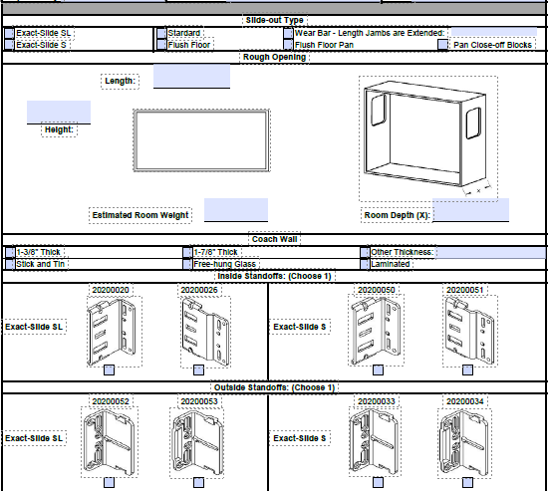

DESIGN PROCESS
WALL OPENING HEIGHT
WALL OPENING LENGTH
ROOM DEPTH
ROOM WEIGHT
WALL THICKNESS
FLUSH FLOOR
WEAR BAR
ROLLERS
STICK AND TIN
LAMINATED
FREE HUNG GLASS
Notes:
Each slide assembly is unique based on the height and length of the rough opening in the main wall and the depth or travel distance of the room. The OEM of the vehicle selects the glide surface and additional seals needed to complete the installation. Once the design criteria has been obtained, a single prototype is developed.

Slide 3

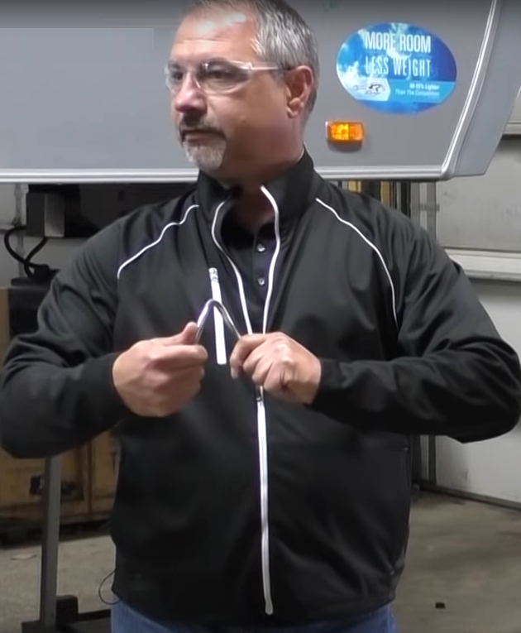
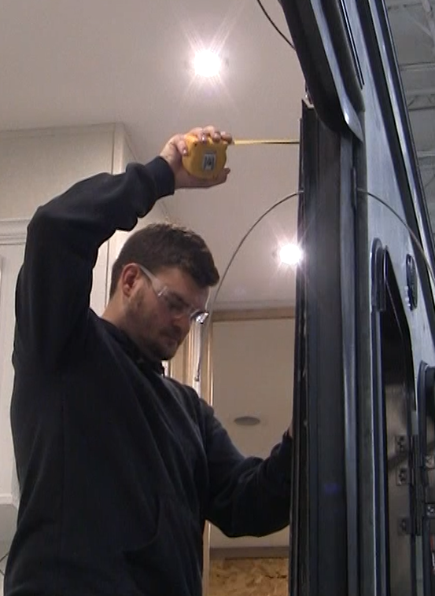
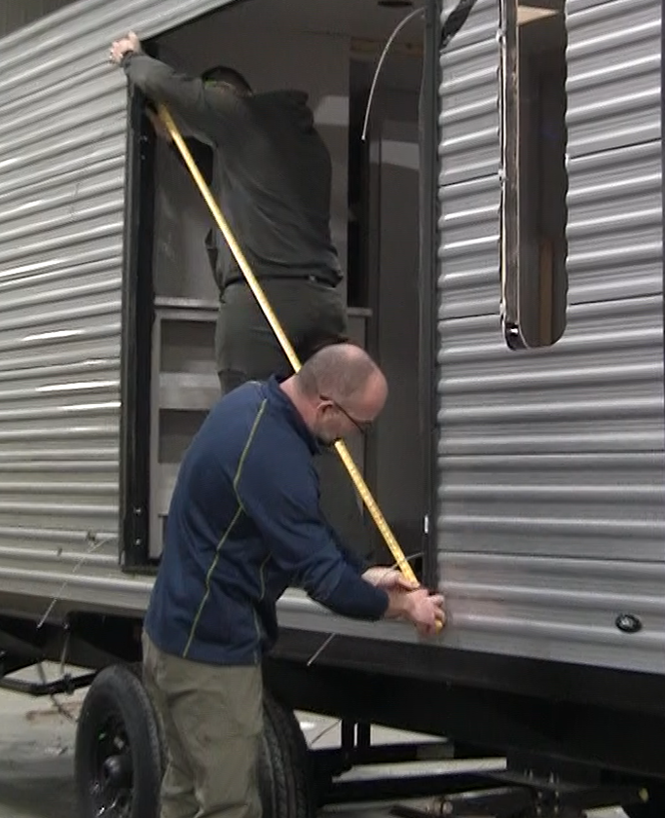
PROTOTYPING
INSTALLATION
Notes:
The B.A.L. Sales, Engineering and Technical Team arrive onsite at the vehicle manufacturer to install the prototype to ensure the design meets the specifications and no engineering changes are needed before the first production run of the product.

Slide 4
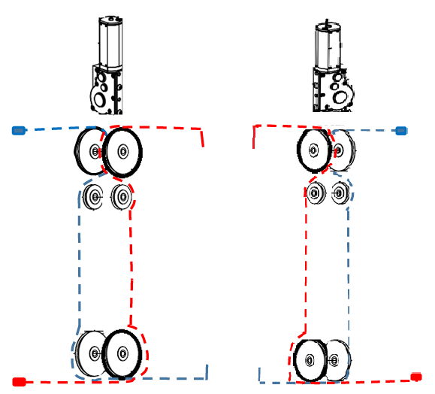
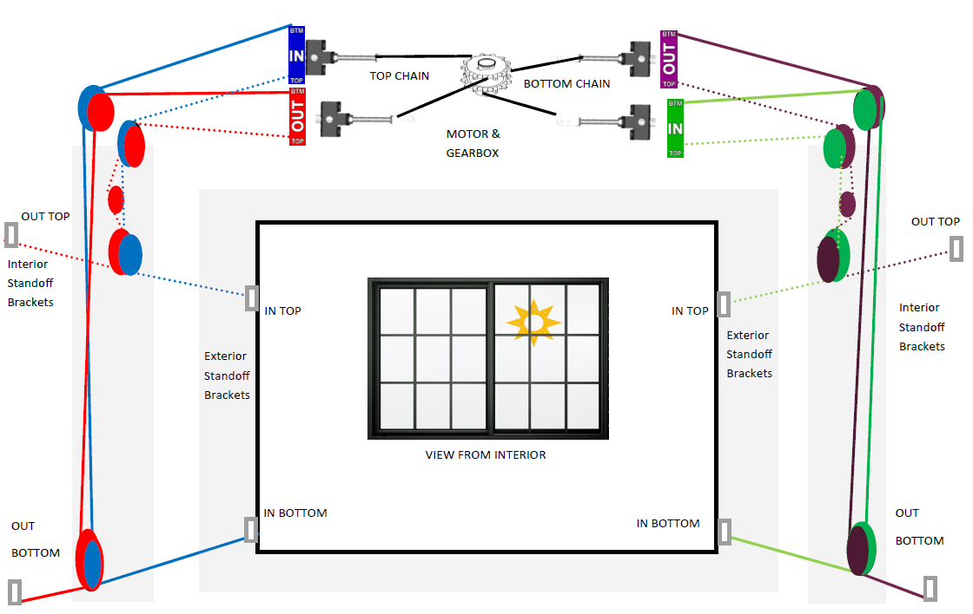
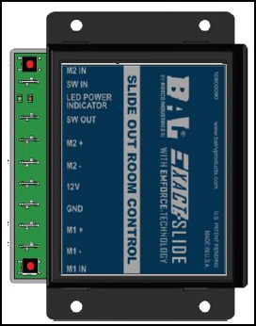
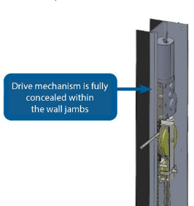
EXACT SLIDE vs. ACCU SLIDE
Dual Motors Mounted at TOP and Left of Slide
Single Motor Mounted above or below the slide
ACCU SLIDE
EXACT SLIDE
Notes:
B.A.L. currently has two main slide types. The dual motor slide has the motor, cables and chain contained in the right and left jamb assemblies. The single motor slide has a motor mounted above or below the room at the center of the opening. The single motor slide has a chain and set of cables that route horizontally to corner pulley brackets then into the right and left jamb assemblies

Slide 5
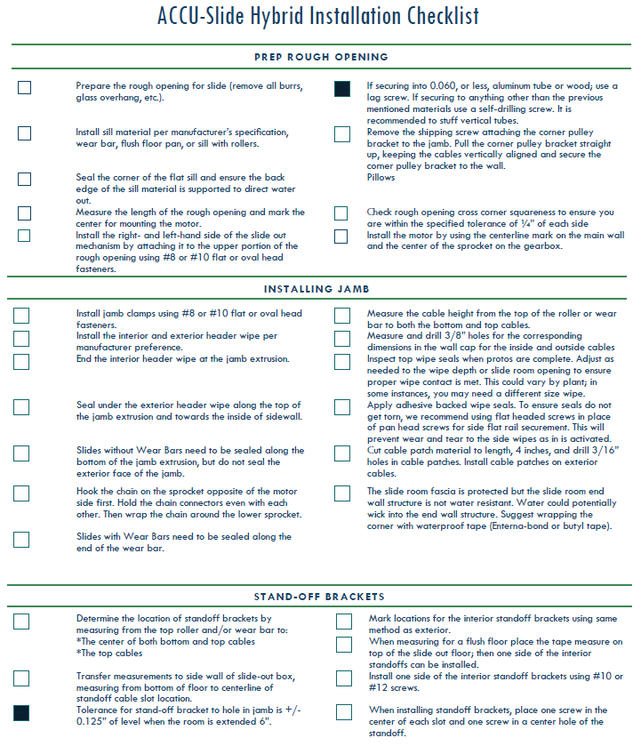
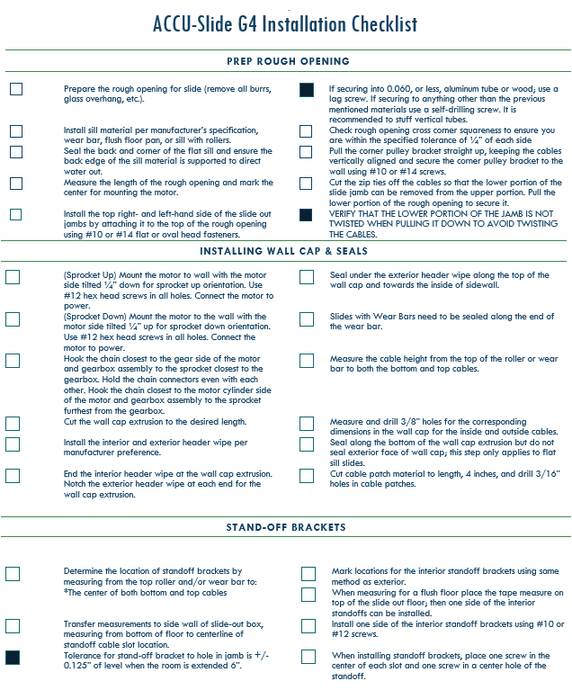
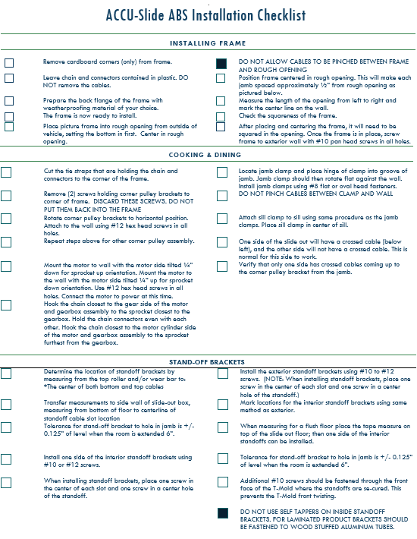
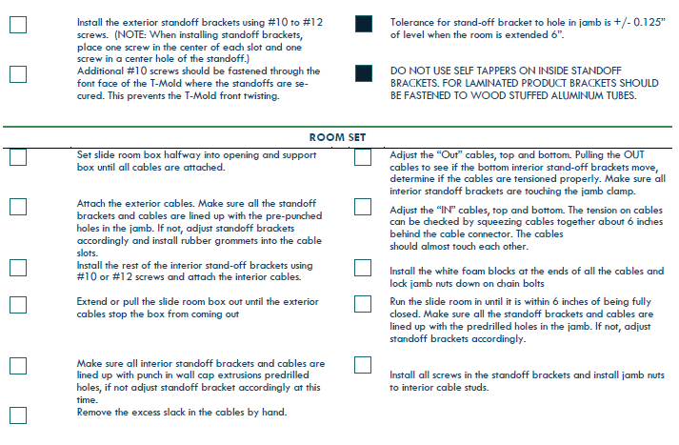
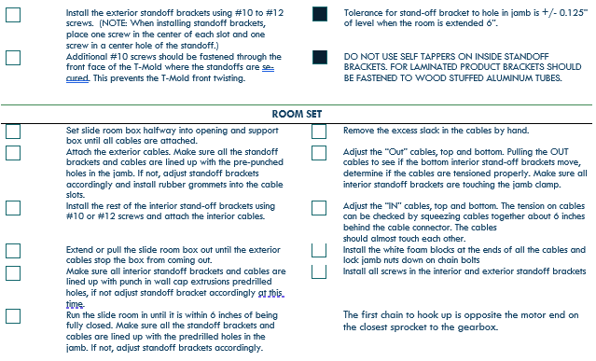
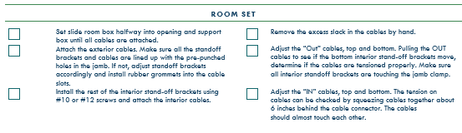
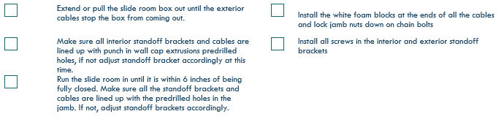
Accu Slide Installation Checklist and Guidelines
Notes:
There are multiple types of Accu-Slides, each with their own sequence of installation steps for the production process.

Slide 6
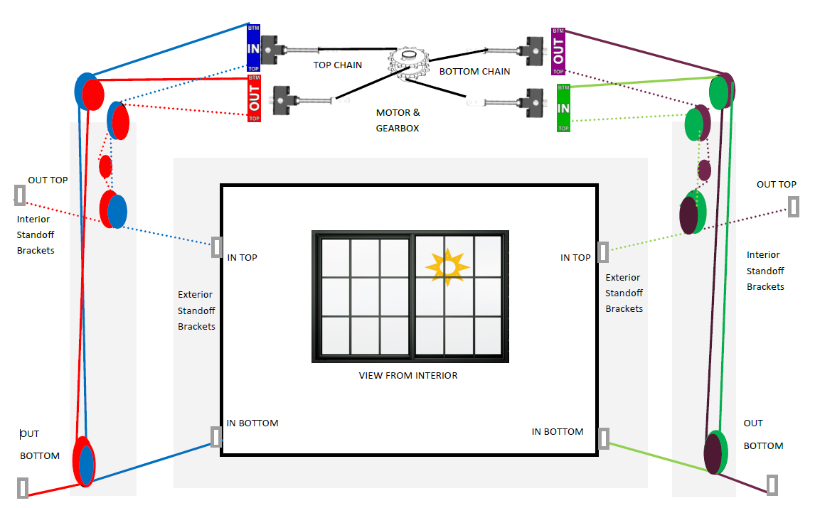
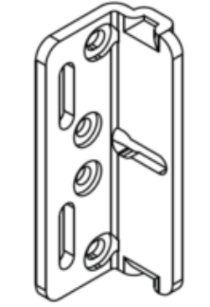

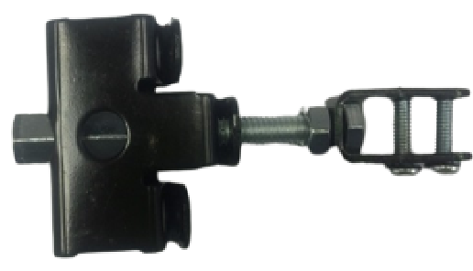
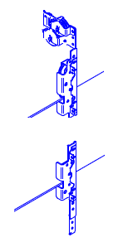
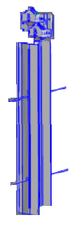
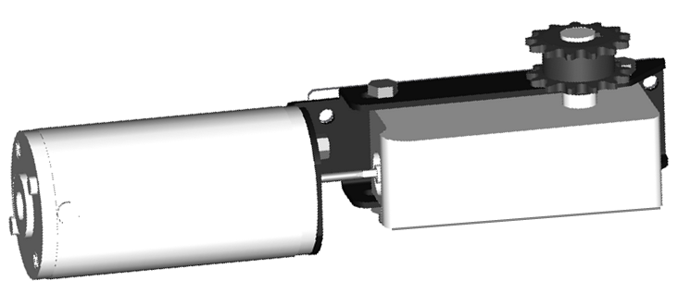
Accu Slide Overview
TERMINOLOGY AND DEFINITIONS
STANDOFF BRACKETS: BRACKETS THAT ARE FASTENED TO THE SIDES OF THE SLIDE ROOM END WALLS, THAT THE BALL ENDS OF EACH CABLE ENDS ATTACH TO.
CORNER PULLEY BRACKET: BRACKETS WITH DOUBLE PULLEYS MOUNTED AT THE TOP OR BOTTOM CORNERS OF THE SLIDE THAT ROUTE THE CABLES TO FROM THE ADJUSTMENT BRACKETS, VERTICALLY TO THE RIGHT AND LEFT OF THE ROOM.
ADJUSTMENT BRACKET: THE CONNECTION POINT BETWEEN THE CABLE AND CHAIN WITH THREE POINTS OF ADJUSTMENT FOR CABLE TENSION.
JAMB: THE LEFT OR RIGHT ASSEMBLY THAT IS FASTENED TO THE ROUGH OPENING, CONTAINING THE PULLEYS, WITH THE CABLES ROUTED THROUGH THEM.
DRIVESHAFT: SMALL FLEXIBLE SHAFT BETWEEN THE MOTOR AND THE GEARBOX.
Notes:
Let’s cover the naming convention on the main components within the system, before we move forward. Standoff brackets are the brackets that are fastened to the sides of the slide room end walls, where the ball end or bullet end of the cable attach. The standoff brackets act as the stopping point for the room and also represent the travel distance. Corner pulley brackets contain double pulleys that can be mounted at the top or bottom corners of the main wall’s rough opening of the slide. The adjustment brackets on the standard Accu-Slide connect the chain to the cables. Each adjustment bracket has 3 points of adjustment. Jambs or jamb assemblies are located vertically to the right and left of the rough opening. They contain pulleys and cables. Drive shafts are used in the motor and gearbox assemblies to allow the motor to turn the gears in the box, which turn the dual sprocket seen on the top or bottom of the gearbox casting.

Slide 7


Cable To Chain Relationship
All standard Accu-Slides have the same cable to chain relationship.
4 cables pull the room out (OUT cables)
4 cables pull the room in (IN cables)
IDLER PULLEY IS SPRING LOADED
IDLER PULLEY IS SPRING LOADED
Interior
Notes:
All standard accu-slides have the same cable to chain relationship. Four cables to pull the room out, also labeled as the OUT cables and four cables to pull the room in, labeled as the in cables.

Slide 8
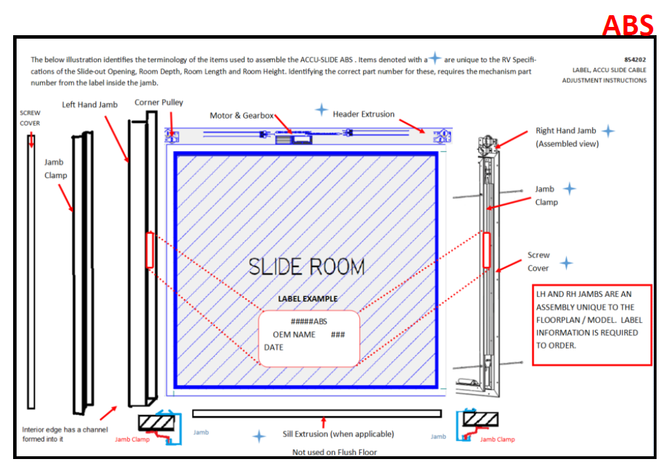
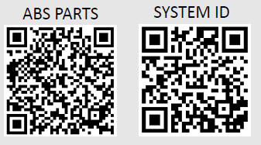
Types of ACCU-Slides: ABS
ABS: Also known as the “picture frame” slide. BAL provides all 4 of the rough opening extrusions, jambs, clamps and seals.
Notes:
The ABS Accu-Slide, also known as the picture frame slide, comes with extrusion or trim and wipe seals for all four sides of the rough opening from B.A.L.. Both sides of the room as well as the bottom, in some applications, will also have a metal jamb clamp, which is part of the structure, although it looks like an interior cover to the cables.

Slide 9
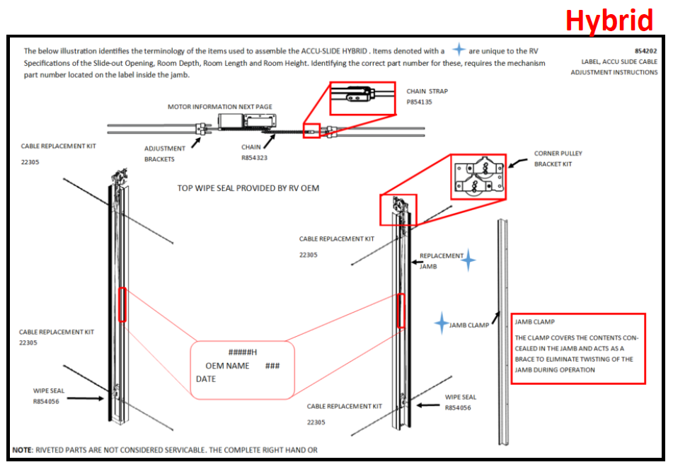


Types of ACCU-Slides: Hybrid
Hybrid: Cross between the ABS and G4, where BAL provides full length jambs on the right- and left-hand side, along with the jamb clamps and seals for the right and left.
Notes:
The Hybrid Accu-Slide, comes with full length jambs, extrusion or trim and wipe seal for the left and right of the room. The vehicle OEM uses top and bottom trim and seals manufactured and procured from other suppliers to the industry.

Slide 10
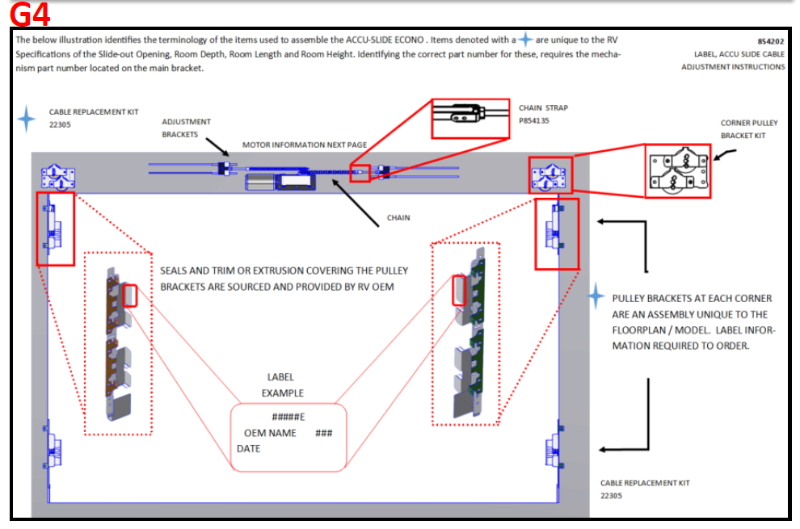


Types of ACCU-Slides: G4
G4: BAL provides jambs that are comprised of brackets mounted at the top and bottom of the right- and left-hand side and the OEM of the trailer provides all covers and seals.
Notes:
The G4 Accu-Slide is comprised of bracket style jamb assemblies that are mounted at the top and bottom at the left and right of the rough opening. The vehicle OEM uses right, left, top and bottom trims and seals manufactured and procured from other suppliers to the industry.

Slide 11
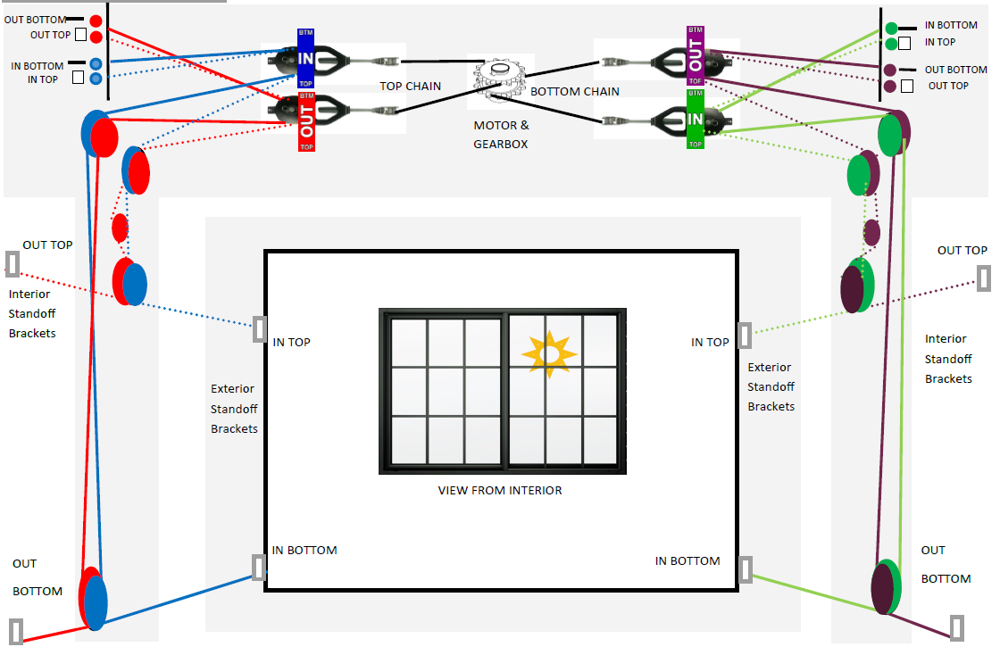
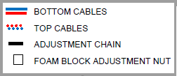

Types of ACCU-Slides: Double Back
Double Back: Intended for deep slides that require longer cables and corner pulley brackets where the adjustments are made.
Notes:
The ABS, Hybrid and G4 Accu-Slides can also be designed as a “Double Back” system. Opposed to the adjustment brackets connecting the cables and chain to the right and left of the motor assembly, there is a chain to double pulley bracket, that allows the cables to loop back to the right and left corners of the rough opening. This allows the cables to be longer to support a deeper slide room or longer travel distance needed. The name originates from the design where the cables route through the vertical jambs, around the corner pulley brackets, loop through the double pulley chain connector and double back to the right and left.

Slide 12
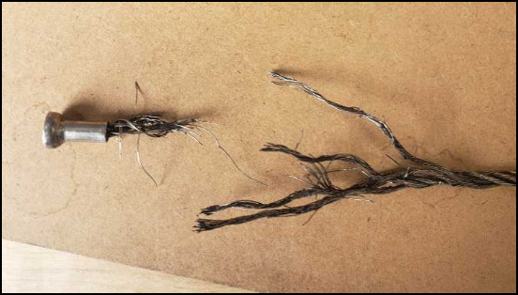
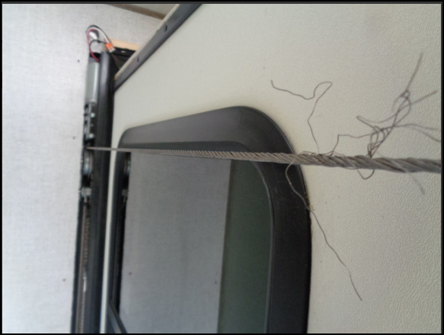

What Causes Frayed Exterior Cables?
AIRCRAFT CABLES ARE PULL TESTED FOR 2,000 LBS. WHEN THEY FRAY OR BREAK THERE IS A ROOT-CAUSE THAT MUST BE DETERMINED AND ADDRESSED TO AVOID A REPEAT FAILURE.
Notes:
Our cables are aircraft quality cables designed to pull in and pull out a slide room up to 2,000 pounds. All our cables are pull tested to 2,000 lbs. This however does not mean you can pull add the 2,000 lbs. and multiply it by four cables for a max of 8,000 lbs. It is important that when a cable has failed that we , not only replace the damaged cable but also remedy the root cause of the cable failure. Standoff bracket placement, clamping need nose pliers to the smooth portion of the adjustment stud, cable pulled off pulley, as well as many other variables. Diagnosing the root cause is crucial to not having repeated cable failure.

Slide 13
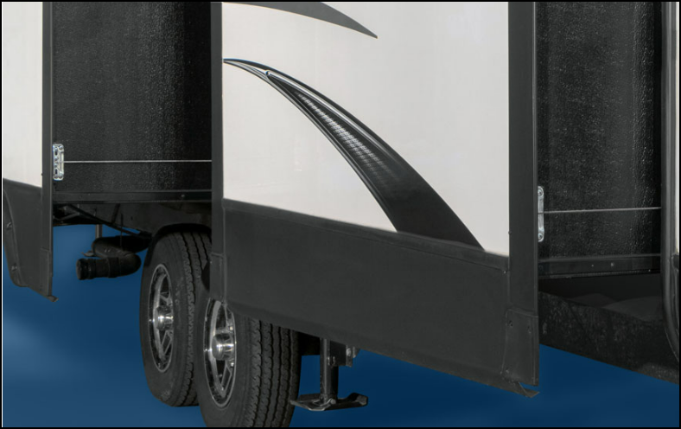
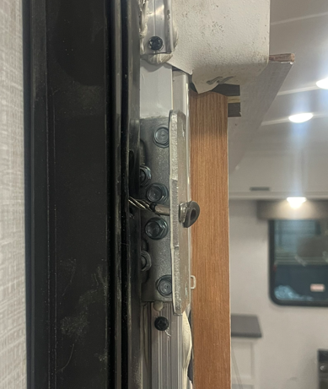
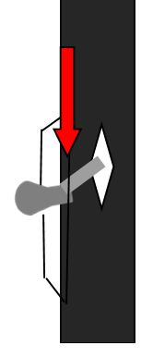
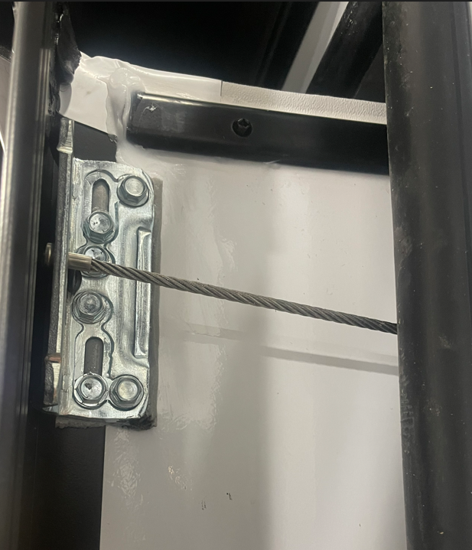
What Causes Frayed Exterior Cables?
The exterior cables have a ball end or bullet end, that sits in the standoff bracket.
With the room extended 6”, ensure the cable is centered with the hole in the jamb.
Standoffs mounted too low or high will cause the bullet end to pinch when it closes against the jamb.
6” Extended
Notes:
Checking proper standoff brkt. location. This should be done with room being retracted to shy of sealing 6”, for your outside standoff brackets. For your interior standoffs, the room should be extended 6” shy of sealing or standoffs touching the vertical jambs. Take a visual inspection of the cable and ensure the cable is running in a straight or level line running back into the jambs. Our specifications are an 1/8” up or down from center. NOTE* The only time this location check will differ is on a Flush floor and on the interior standoff brkts. only. Extend the room to a point where the brackets are just barely off the jamb and visually inspect the cable from this point.

Slide 14
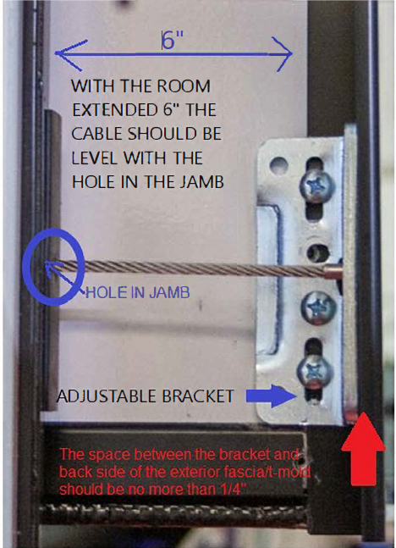
Adjusting The Standoff Bracket Location
Notes:
Only time this would vary would be on the interior standoff brackets on a flush floor. You would bump the room in from the extended position to where the stand off looses contact with the extrusion to verify the brackets are aligned correctly. Outside brackets on the flush floor would still be checked from the 6” from the sealed position.

Slide 15
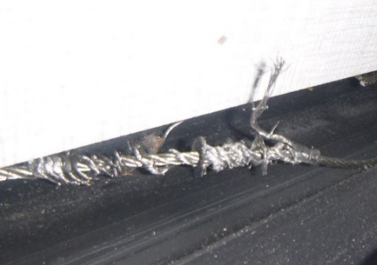
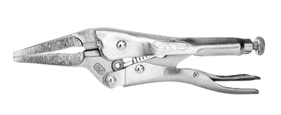
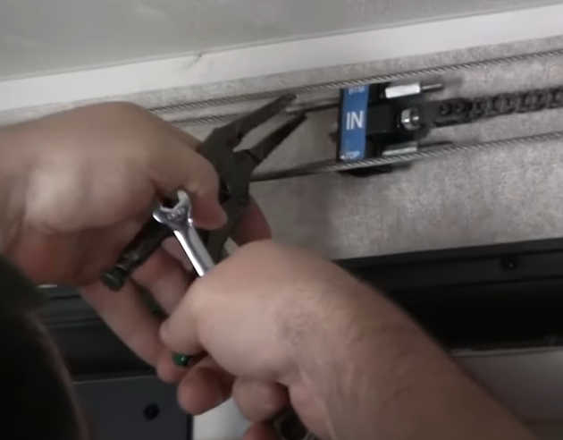
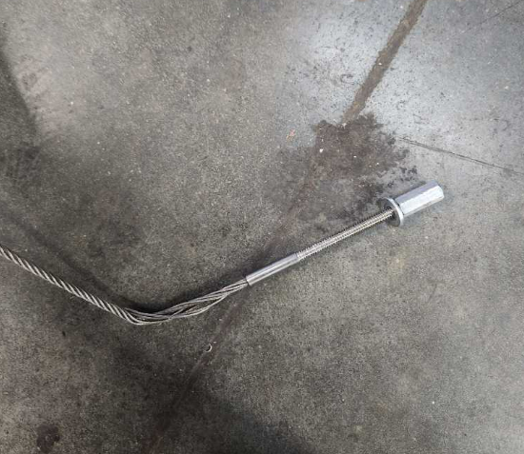
Cable strands twisted around the cable
Adjusting the system without holding the threaded end of the cable in place with needle nose vice grips will twist the cable at the same time.
Cable strands unspun
CLAMP TO BARREL AREA OF CABLE END
Notes:
Using clamping style needle nose pliers are required during the adjustment process on any of the Norco/Bal cable driven slideouts. The reason behind this is that the cable while being tensioned can start to spin and in doing so can unspun itself from the clamped end of the adjustment stud. Once a cable has started to become unspun it will eventually fail do to the integrity of the cable being compromised.

Slide 16

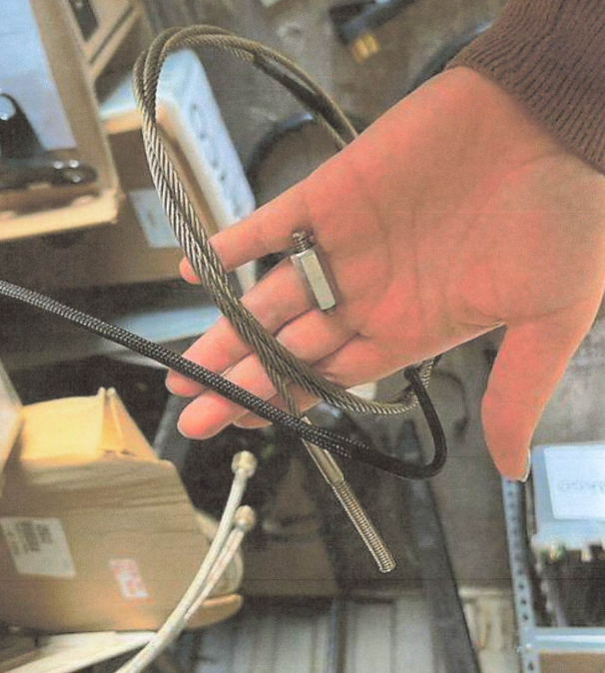
The threaded end of a cable can break for three reasons:
During installation or adjustment, power tools were used on the coupler nut, and the nut was spun welded to the threaded end.
The adjustment bracket was tilted left or right and was not straight up and down after installation or adjustment.
The chains were not on the correct gearbox sprocket, causing the adjustment bracket to hit the end of the motor during operation.
Notes:
Power tools being used during the adjustment process can weld spin the nut to the stud. At which point the cable or the cable stud needs to be replaced.
Jamb nut not tightened to the adjustment bracket properly and the In and Out bracket collided during operation.
Chain to sprocket relationship was incorrect, barrel side of motor chain should go on sprocket last. If not, the cable studs and adjustment brkt has the potential to hit the drum or barrel of the motor locking up the room or breaking the cable stud ends.

Slide 17
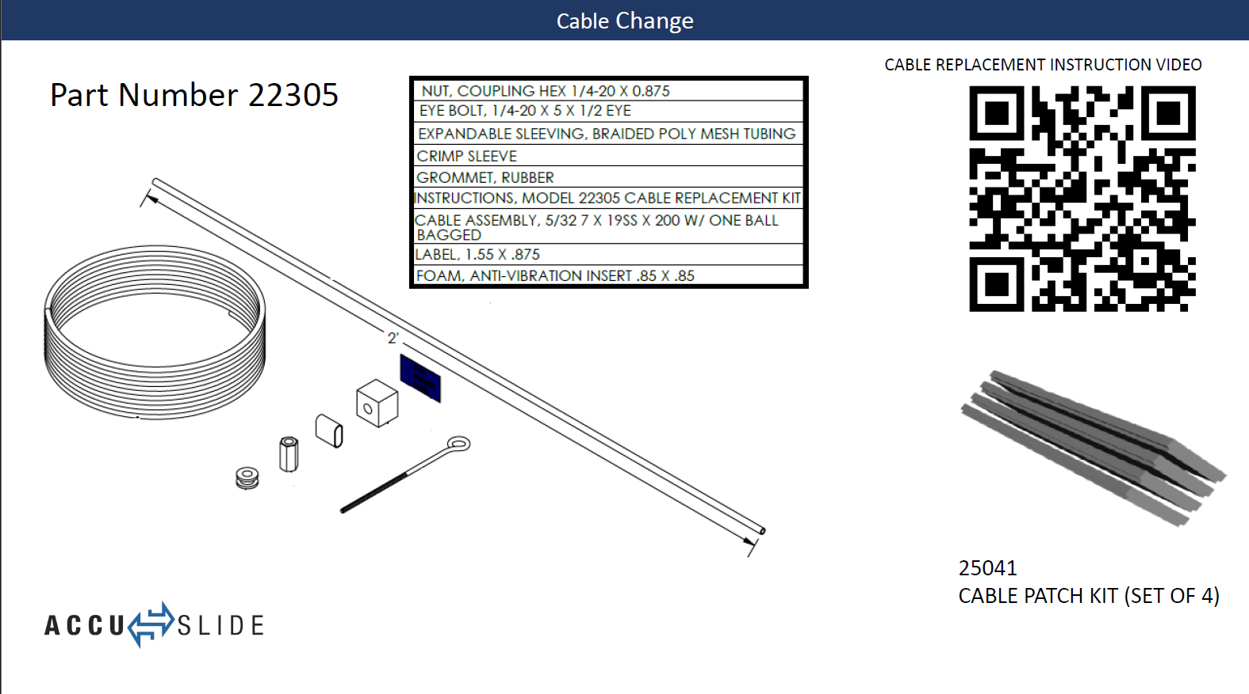
Notes:
This kit can be used on BAL exact slide for external cable repairs as well

Slide 18
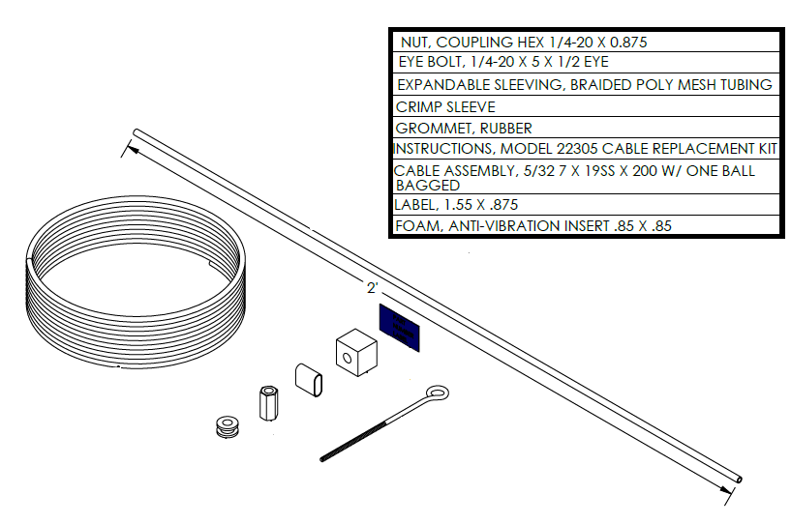
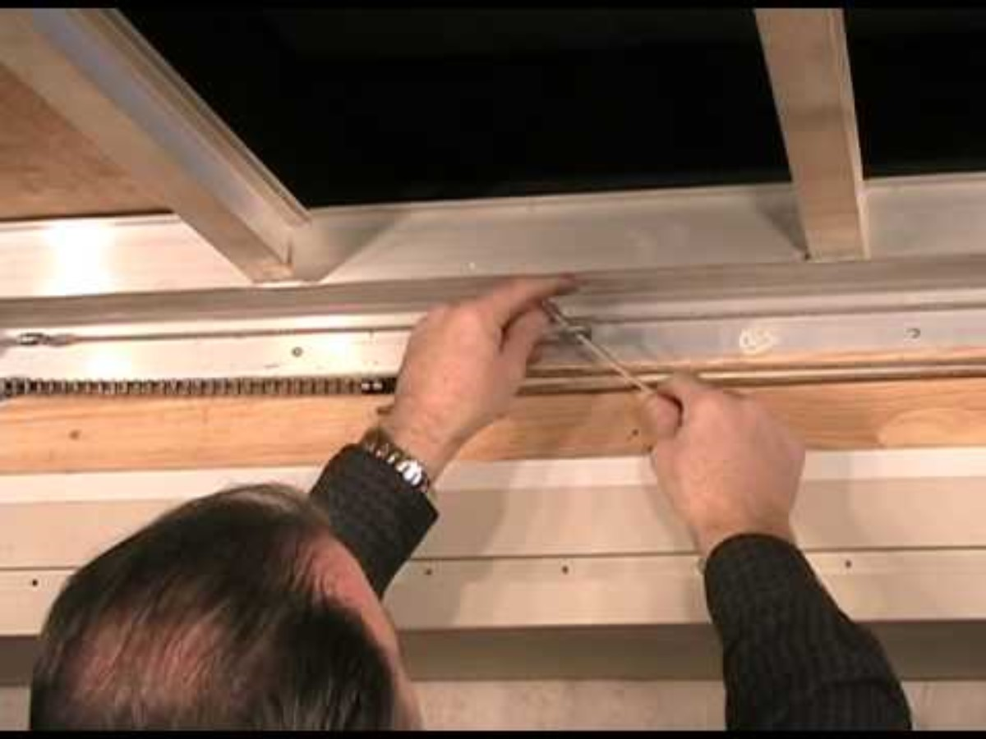

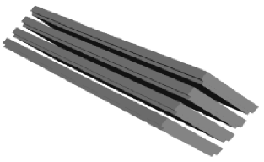
Cable Change
Part Number 22305
CABLE REPLACEMENT INSTRUCTION VIDEO
25041
CABLE PATCH KIT (SET OF 4)
Notes:
Here we have a video on how to do a cable replacement on the Accuslide. Important to note that all adj”s. are done from the extended position as well as cable replacements.

Slide 19
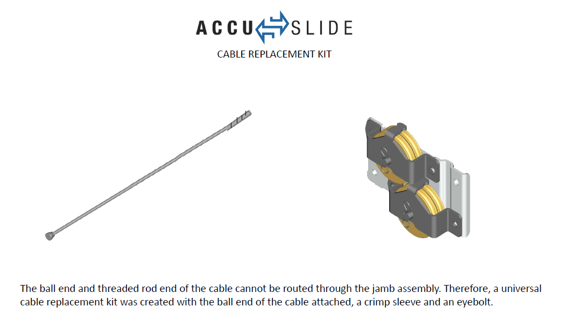
Notes:
We are asked all the time, why can’t you just put another cable in like I had. Simply put the stud end will not fit through the system once it has been manufactured.

Slide 20
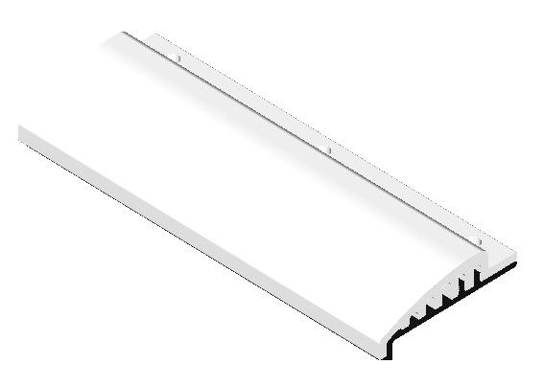
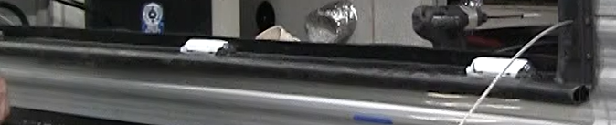
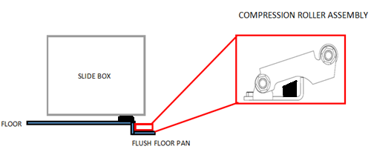
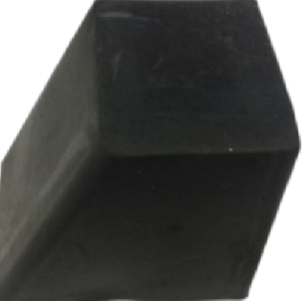
Identifying Glide Surfaces
Does it have a wear bar, rollers or is it a flush floor?
When the weight it off the rollers, do they easily spin by hand?
Are all rollers touching the bottom of the room during operation?
How many rollers are installed under the room? Most roller are rated for 150 lbs – 200 lbs, depending on the supplier.
Verify the fasteners in the wear bar are not sitting higher than the wear bar.
Verify the wear bar is not wavy.
Verify the wear bar is not damaged.
Is the compression block losing its shape?
Is it too small?
How long the room is and what appliances/furniture are installed?
Note: Refrigerators are approx. 12 lbs per cubic foot.
Notes:
Glide surface issues in the field.
Rollers no longer rolling freely without weight off the rollers
Screw heads sticking up above the wear bar on flush floor
Compression block has lost its retention and needs replaced.

Slide 21
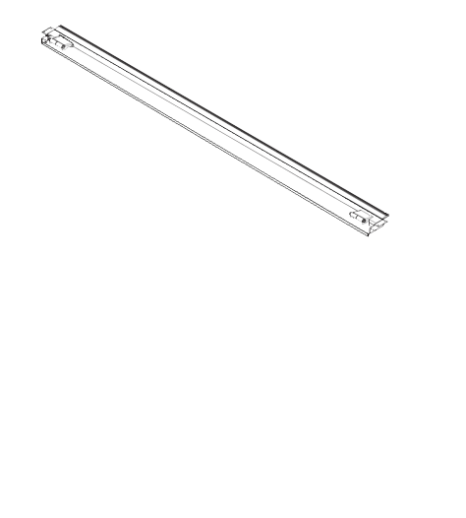
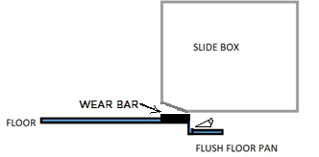




Flush Floor Design
Combination of wear bar, pan and compression rollers.
WEAR BAR
FLUSH FLOOR PAN
COMPRESSION ROLLER AT EACH END OF THE PAN
Notes:
When Flush floor design is being incorporated with our pan with the compression rollers, the roller should make continuous contact with the floor until the room breaks the plain of the wear bar. If it does not do this then a compression block change may be needed.

Slide 22




Flush Floor Design – Replacing the Rubber Block
COMPRESSION BLOCK REPLACEMENT INSTRUCTIONS
Notes:
Replacement of compression blocks…
When it has been determined that the blocks have lost their compression, you will need the following tools as well as replacement compression blocks.
Floor jack, channel locks, F845734x2 compression blocks, zep 45 or another food grade lubricant and a block of wood to help jack up on the room.

Slide 23

Faux Flush Floor Design Without Compression Rollers
Notes:
We see the 1/8” laminated lauan coming loose from the floor right before the beveled nose. This area catches the wear bar as the room is being retracted. Find the loose lauan and secure it properly to the floor to see this issue go away.

Slide 24
Faux Flush Floor Design Without Compression Rollers
PLASTIC GLIDE STRIP PIECES ALONG INSIDE EDGE OF METAL PAN
NEWER FAUX FLUSH FLOOR DESIGN FOR THE INDUSTRY FOR 2024
BOTTOM OF SLIDE FLOOR HAS A BEVELED NOSE THAT GLIDES ACROSS THE METAL SLOPED MAIN FLOOR PAN
Notes:
Mimics a true flush floor. This has not been tested at our facility. Weight rating have not been determined and we have seen issues with the room transitioning abruptly when breaking the plain of the pan onto the subfloor.

Slide 25




Old Style Wear Bar
SERVICE ROLLERS CAN BE ADDED WITHOUT REMOVING THE SLIDE OR THE OLD WEAR BAR.
½” TALL ROLLER – PART NUMBER 854304
¾” TALL ROLLER – PART NUMBER 854303
Older style wear bars used in the past were not all solid core. Over time the weight of the room may cause the room to skip during operation, prohibit the room from fulling extending at the bottom or add additional strain on the motor and gearbox assembly.
Link to roller installation instructions
Notes:
Measure from the subfloor to the top edge of the wear bar at the ends to determine what size roller is needed to properly replace wear bar.

Slide 26


Adding Additional Rollers
PART NUMBER 854275
SERVICE ROLLERS AT THE SAME HEIGHT OF THE ORIGINAL 1.00” ROLLERS CAN BE ADDED WITHOUT REMOVING THE SLIDE.
PART NUMBER 22324
Notes:
Service roller 22324 can be added to an opening without removing the slideout box from the opening. If the service roller needs to go in the same place as a current roller 854275, the old roller can be removed by using a saw zaw or recipicating saw.

Slide 27

Weight Limitations for the Accu-Slide
BAL SLIDE TYPE | GLIDE SURFACE | MAX ROOM WEIGHT
ACCU SLIDE | BAL ABOVE FLOOR ROLLERS | 2000
ACCU SLIDE | ABOVE FLOOR SOLID CORE WEAR BAR | 1800
ACCU SLIDE | BAL FLUSH FLOOR PAN | 1600
ACCU SLIDE | METAL FAUX FLOOR WITH 12 DEGREE RAMP | 1100
ACCU SLIDE | FOREST RIVER GIGGY FLOOR | 1000
BAL Rollers are rated for 200 lbs. Additional rollers may be required depending on the application.
Notes:
Note that the quantity of rollers may vary depending on extra weight or weight differences within the slide box.

Slide 28


Resistance
You should have a 5/8" gap from top to bottom on each side of the room between the slide-out end wall and the metal portion of the jamb, when pulling back the wipe seal, as the overall width of the rough opening, before the jambs are fixed to each side should be 4.25" wider than slide box (finished edge of fiberglass to finished edge of fiberglass).
If there is not 5/8" clearance from top to bottom on both sides, then you will want to check the following and then reach out to the RV OEM with your findings on the VIN for guidance.
Confirm that the jamb assembly is fully seated against the rough opening.
Confirm that the jambs are not twisting during operation of the room.
Cross measure the slide room for squareness.
If you find that the gap on each side of the room changes, during extend/retract, measure the interior width of the slide at the back of the slide room and the interior width of the slide at the front of the slide room.

Slide 29



Corner Pulley Brackets Pulled Out of Wall
There are two main causes for a corner pulley bracket to pull from the wall:
Self-tapping screws should not be used when installing the brackets, as that type of screw will act as a drill bit and bore out the hole. Use #10 wood screw.
The ¼” jamb nut for the chain, was not secured against the adjustment bracket allowing the bracket to tilt forward or backward and the adjustment brackets collided during operation.

Slide 30



Fray or Break at Corner Pulley Bracket
PLACE YOUR HAND ON THE WALL BESIDE THE CORNER PULLEY BRACKET WHILE SOMEONE OPERATES THE ROOM.
IS IT TILTING DURING OPERATION?
IF THE WALL IS BULDGING OR OPENING STRUCTURE IS DAMAGED, YOU MUST PLATE THE WALL BEHIND THE CORNER PULLEY BRACKET TO THE CEILING!

Slide 31




Corner Pulley Bracket Installation
Notes:
Its also worth mentioning that when you are adding mounting screws be sure to pull the cables tight to the pulleys to ensure you are not pinching them behind a pulley strap when securing the corner pully bracket to the wall.

Slide 32




THE CENTER OF THE DUAL SPROCKET ON THE GEARBOX SHOULD BE ALIGNED WITH THE CENTER LINE OF THE ROUGH OPENING.
MOTOR INSTALLATION
MOTOR REPLACEMENT INSTRUCTION VIDEO
Notes:
Here we have a video of proper alignment, adjustment and motor change on the Accuslide

Slide 33
Adjustment Bracket is hitting the motor cylinder during operation
What sprocket is the chain attached to?
Is the motor and gearbox assembly mounted with a ¼” tilt away from the chain?
Notes:
This clip shows the incorrect way to mount the chains to the double sprocket on the motor. Also showing the motor assembly on an even plain. Barrel side of the motor should have a ¼” tilt away from the chains to ensure proper clearance for the cable adj. bracket to clear the barrel of the motor.

Slide 34


MOTOR ORIENTATION
(Sprocket Up) Mount the motor to wall with the motor side tilted ¼” down for sprocket up orientation. Use #12 hex head screws in all holes. Connect the motor to power.
(Sprocket Down) Mount the motor to the wall with the motor side tilted ¼” up for sprocket down orientation. Use #12 hex head screws in all holes. Connect the motor to power.

Slide 35


Motor Mounting Bracket Bent Down, Not Installed at a Tilt
=
DAMAGED DRIVESHAFT

Slide 36


Drive Shaft Failed, but Motor bracket is not bent.
IN
OUT
A STUCK SWITCH WILL SEND POWER TO THE MOTOR WITHOUT MANUAL OPERATION.
THE THERMAL CUT OFF INSIDE THE MOTOR WILL INITIATE EVERY 15 SECONDS AND EACH TIME, THE DRIVE SHAFT WILL ATTEMPT TO TURN SLIGHTLY.
=
DAMAGED DRIVESHAFT
THERMAL CUT OFF IN MOTOR AT 30 AMPS

Slide 37

Manual Override
Notes:
While there are multiple types of slide motors that may be used in the application, all of them have a manual override socket in the end of the motor and are provided with a manual override flex shaft with a #3 square bit. The flexible shaft is necessary to prevent damaging the gearbox, as the shaft will twist to prohibit over torquing. The two-piece assembly motors with the drive shaft visible between the motor and gearbox, also allow the flex shaft and #3 bit to be inserted directly into the gearbox in the event the motor has seized.

Slide 38


Proper Cable Adjustment
BEFORE STARTING THE TENSIONING PROCESS, WITH THE ROOM EXTENDED, GRAB THE OUT BTM AND PULL ON THE CABLE WITH YOUR HAND TO SEE IF THE ROOM PULLS AGAINST THE WALL AND/OR IF THE BOTTOM STANDOFF BRACKETS ARE MAKING CONTACT WITH THE JAMB.
Notes:
New and improved cable adjustment sticker. Now it not only tells you what bracket should go where on the top or bottom of the slide opening, it also gives you a 13 step process on how to adjust the room properly.

Slide 39

Proper Cable Adjustment

Slide 40


Proper Cable Adjustment
OUT BTM CABLE PULLS THE BOTTOM OF THE ROOM OUT
OUT TOP CABLE PULLS THE TOP OF THE ROOM OUT
IN BTM CABLE PULLS THE BOTTOM OF THE ROOM IN
IN TOP CABLE PULLS THE TOP OF THE ROOM IN
Notes:
Here we have a diagram showing what the brackets should look like when installed to the motor sprocket. We also have a list of tools that are required to achieve this.

Slide 41
Proper Cable Adjustment
THE ROOM MUST BE COMPLETELY EXTENDED
THE ¼” JAMB NUT MUST BE SECURED AGAINST THE ADJUSTMENT BRACKET TO KEEP THE ADJUSTMENT BRACKET FROM TILTING BACKWARDS AND FORWARDS.
DON’T FORGET THE ANTI-VIBRATION FOAM BLOCKS.
WHAT IF YOU DON’T HAVE ANY FOAM BLOCKS?
Notes:
Securing the jamb nut once you’ve completed the adjustment process is key to making sure the in and out labeled brackets do not collide with one another on either side of the motor. If you can spin the jamb nut away from the cable adjustment bracket then its not secured tight enough. If you do not have anti vibration foam blocks you can use a ¼” 20 free running nut on the end of the cable stud and lock it down tight to the 3/8” nut for cable adjustment that will do the same function as the block would have.

Slide 42


Proper Cable Adjustment – Double Back
Notes:
Double back adjustment process along with tool list required.

Slide 43

Proper Cable Adjustment – Double Back

Slide 44


Proper Cable Adjustment – Double Back
THE ¼” JAMB NUT MUST BE SECURED AGAINST THE DOUBLE PULLEY CHAIN CONNECTOR.
DON’T FORGET THE ANTI-VIBRATION FOAM BLOCKS ON EVERY OTHER COUPLER NUT.
Notes:
Don’t forget to add your abs divider to prevent the pulleys connected to the chain from hitting one another when passing one another during operation of slide out. Required for the double back system

Slide 45


Proper Cable Adjustment – Double Back
Z-Divider Removed
Z-Divider Installed
Notes:
Don’t forget to add your abs divider to prevent the pulleys connected to the chain from hitting one another when passing one another during operation of slide out. Required for the double back system

Slide 46


Free Hand Routing a New Cable
USE YOUR NEEDLENOSE PLIERS TO BEND THE SOUDERED END OF THE CABLE INTO A HOOK SHAPE.
FEED THE HOOK END OF THE CABLE AROUND THE PULLEY BY HAND.
USE THE NEEDLENOSE VICE GRIPS TO TURN, PUSH AND PULL THE CABLE UNTIL THE HOOK END OF THE CABLE ROUTES AROUND THE CABLE.
PRO TIP ON CABLE CHANGE
SMALL PULLEY AND SPRING

Slide 47



After tensioning, the bottom of the room kicks back in.
SLIDE ROOM EXTENDED PROPERLY
SLIDE ROOM EXTENDED
MAIN FLOOR OF RV
MAIN FLOOR OF RV
IF A JACK IS PLACED UNDER THE ROOM TO SUPPORT A HEAVY SLIDE DURING TENSIONING AND THE ROOM KICKS BACK IN AFTER REMOVING THE JACK, THIS IS AN INDICATION THAT EITHER:
THE MOTOR MAGNETS HAVE WEAKENED AND THE MOTOR MAY NEED TO BE REPLACED.
THE GLIDE SURFACE UNDER THE ROOM IS DEFORMED OR DAMAGED.
Notes:
The room kicking back in after the proper adjustment have been made can be caused from weakened motor magnets which allow the bottom of the room to creep in on itself, also , the glide surface under the room is deformed or damaged.

Slide 48




MAIN FLOOR OF RV
MAIN FLOOR OF RV
ROOM NOSE DIVES INTO THE FLOOR
CHECK ADJUSTMENT FIRST
PLACE A LEVEL OR STRAIGHT EDGE ON THE MAIN FLOOR IN THE RV TO MAKE SURE IT IS FLAT AND NOT CURVING UP.
PLACE A LEVEL ON THE FLOOR OF THE SLIDE TO MAKE SURE IT IS FLAT AND STRAIGHT
WILL NOT SEAL?
CHECK ADJUSTMENT FIRST
IF A CABLE WAS CHANGED IN THE HALF- WAY POSITION IT WILL BE TOO SHORT.
EXTERIOR CABLE DISCONNECTS FROM THE STANDOFF BRACKET AND PULLS THROUGH THE HOLE IN THE JAMB.
REMOVE EXTERIOR CABLE PATCH
USE FORCEPTS OR HOOK END TOOL TO GRAB THE BALL END OF THE CABLE OUT OF THE JAMB.
CHATTERING
SCREWED?
CHATTERING SOUND COMING FROM THE RIGHT OR LEFT OF THE ROOM?
IS THE WALL FLEXING AT CORNER PULLEY BRACKET DURING OPERATION?
IS THE BOTTOM OF THE CORNER PULLEY BRACKET DIGGING INTO THE WALL? SHIM NEEDED
SCREW DROPS DOWN INTO THE JAMB AND GETS WEDGED INTO THE PULLEYS?
CUT THE CABLE AND PULL IT OUT IN THE DIRECTION THAT IT WILL MOVE.
USE A LEAF BLOWER AT THE BOTTOM OF THE JAMAB OR AIR COMPRESSOR. THEN HOLD A MAGNET TO CATCH THE SCREW OUT THE TOP
CABLE IS A BIRD’S NEST STUCK INSIDE?
IF THE NEST IS ON AN EXTERIOR CABLE, CUT THE CABLE INSIDE NEAR THE ADJUSTMENT BRACKET AND OPERATE THE MOTOR TO PULL THE NEST OUT.
Notes:
We have a series of common issues we have had some calls on.
We have document them here along with symptoms and actions needed to take care of the issue.

Slide 49



Function of The Jamb Clamp
Cycling the room without the jamb clamp clipped into the jamb from top to bottom could cause the jamb to twist.
JAMB CLAMP EDGE IS BEVELED TO CLIP INTO JAMB
EXTRUSION EDGE HAS A CHANNEL
Notes:
Cycling the room without the Jamb clamp secured can cause the jamb to twist and take up the spacing needed between the jamb and the slideout box. This could result in torn wipe seal or damage to the jamb itself.

Slide 50

HYBRID JAMB PROFILE AND WIPE SEAL END VIEW
To remove the wipe seal: Loosen the pinch points at the top and bottom of the channel with a flat head screwdriver or chisel. Then pull the seal out of the channel.
To install new seal:
Use a flat head screwdriver or chisel to help press the new seal into the channel, so that the barbs catch inside the channel of the jamb.
ABS &
ABS &

Slide 51








Water Infiltration and Where to Investigate
Bottom of Jamb to Wear Bar
Inside Corner at Top of Jamb
Top Bulb Seal
T-Mold Flares
Seal at Bottom Sill to Rough Opening
Support or Cleat Behind Sill Material
Outside Edge at Top of Jamb

Slide 52


Water Infiltration and Where to Investigate

Slide 53


Water Infiltration and Where to Investigate

Slide 54

Water Infiltration and Where to Investigate
RAISED PAN/SILL MATERIAL WITH WATER DAM
CORNER CUPS AT THE END OF THE SILL MATERIAL
FOLD AND TUCK METHOD
THIS IS NOT ENOUGH SEALANT TO CREATE A WATER DAM.

Slide 55




Interior Stand-off Brackets Pulled Out of Wall
Self-tapping screws should not be used when installing the brackets, as that type of screw will act as a drill bit and bore out the hole
6” X 2.88”
6” X 1.13” LIP
21700148
REINFORCEMENT PLATE SERVICE KIT (SET OF 4) 14 GA STEEL E-COAT
Exterior Standoff Brackets may use self-tappers for attachment to exterior t-mold fascia.

Slide 56

Electrical Troubleshooting
30 AMP RESET
BREAKER
SLIDE-OUT SWITCH
IN
OUT
10V-12V IN
10V-12V IN
SLIDE-OUT MOTOR & GEARBOX
POWER SOURCE
10V-12V OUT
10V-12V OUT
Natural voltage drop under load with 12v
< 65’ 10 GAUGE WIRE
> 65’ 8 GAUGE WIRE
TRY ALTERNATE POWER SOURCE DIRECTLY TO THE MOTOR. IF THE MOTOR DOES NOT WORK, THE MOTOR IS THE ISSUE.
CHECK VOLTAGE COMING TO THE MOTOR WHILE OPERATING THE SWITCH. IF IT IS LOWER THAN 12V, CHARGE OR REPLACE BATTERIES. LESS THAN 9 VOLTS WILL CAUSE THE THERMAL CUT OFF WITHIN THE MOTOR TO CUT POWER TO ITSELF.
CHECK VOLTAGE COMING IN AND OUT OF THE SWITCH UNDER LOAD. THE ISSUE COULD BE THE SWITCH, THE BREAKER OR THE WIRING IN BETWEEN.

Slide 57

Electrical Troubleshooting

Slide 58

Electrical Troubleshooting

Slide 59


Access To Online Part Numbers
www.balrvproducts.com
Search by Part Number
Search by Description
Scroll through product images
Order repair parts online

Slide 60




Identifying the Mechanism/Complete Slide Assembly Part Number
Remove the Jamb Clamp or Wall Cap to access the part number label.

Slide 61




balrvproducts.com
Visit balrvproducts.com for product detail, installation guides, videos and more.

Slide 62

Any questions?

